Slide 1
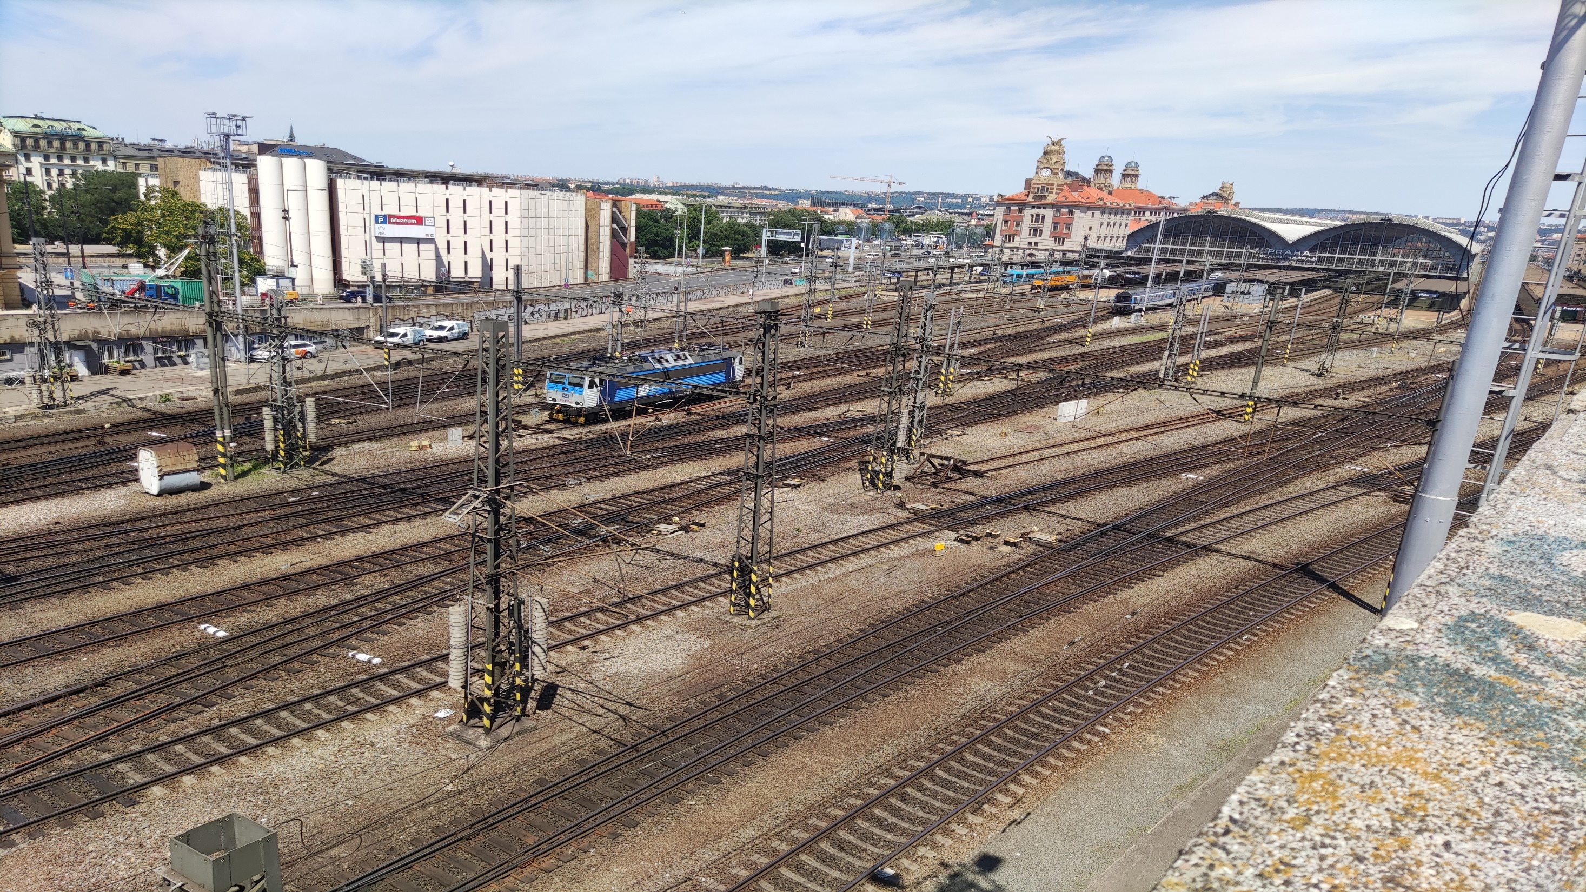
ERASMUS + studentska mobilnost Prag 2023.
ERASMUS + student mobility Prague 2023.
Miloš Milanović

Slide 2
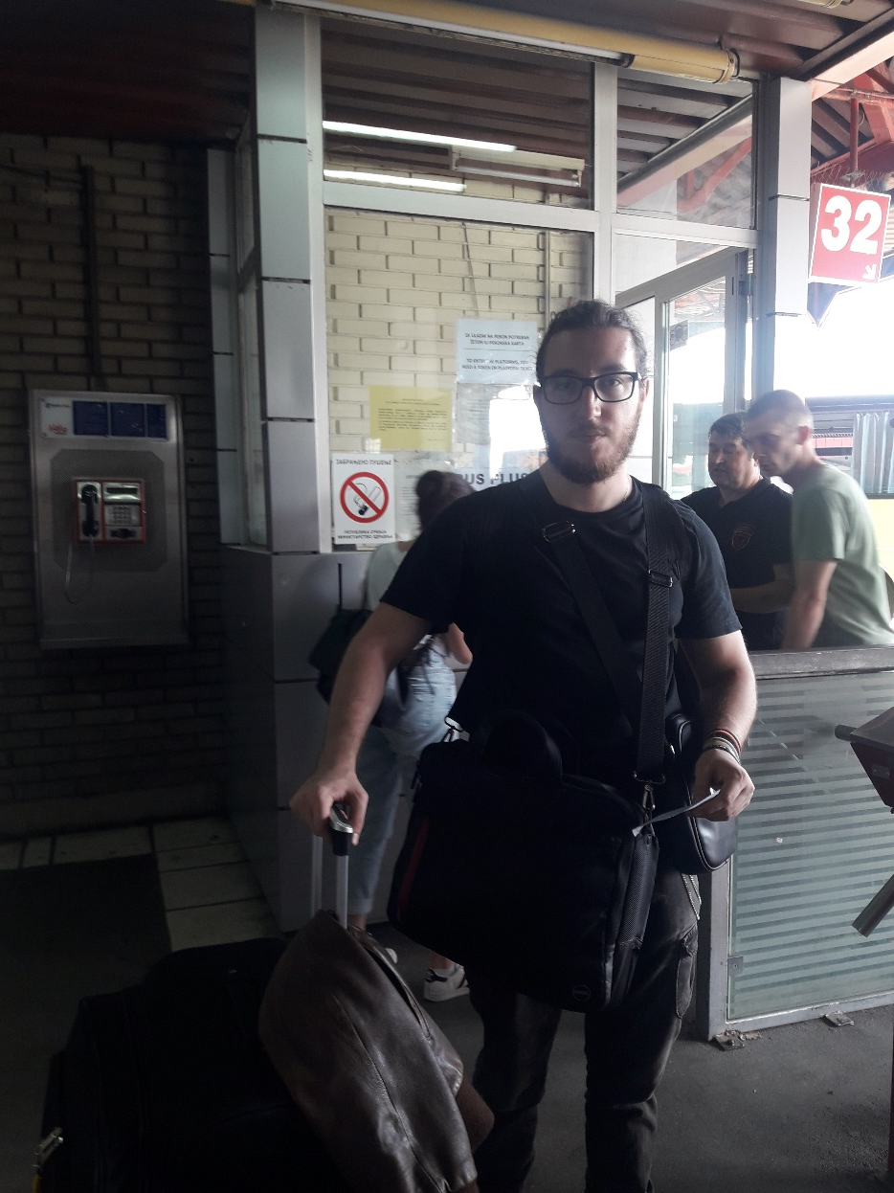
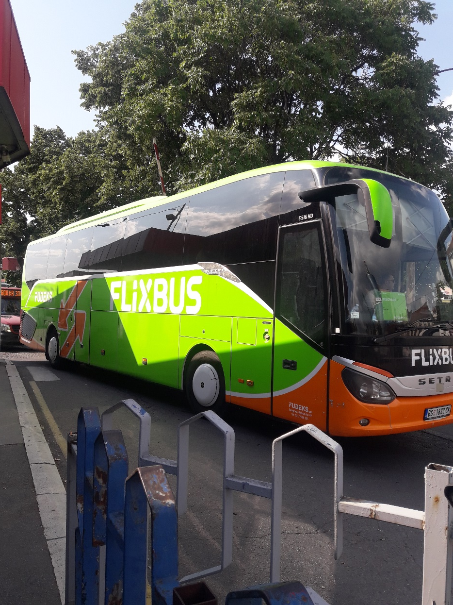
Polazak na put
The journey begins

Slide 3
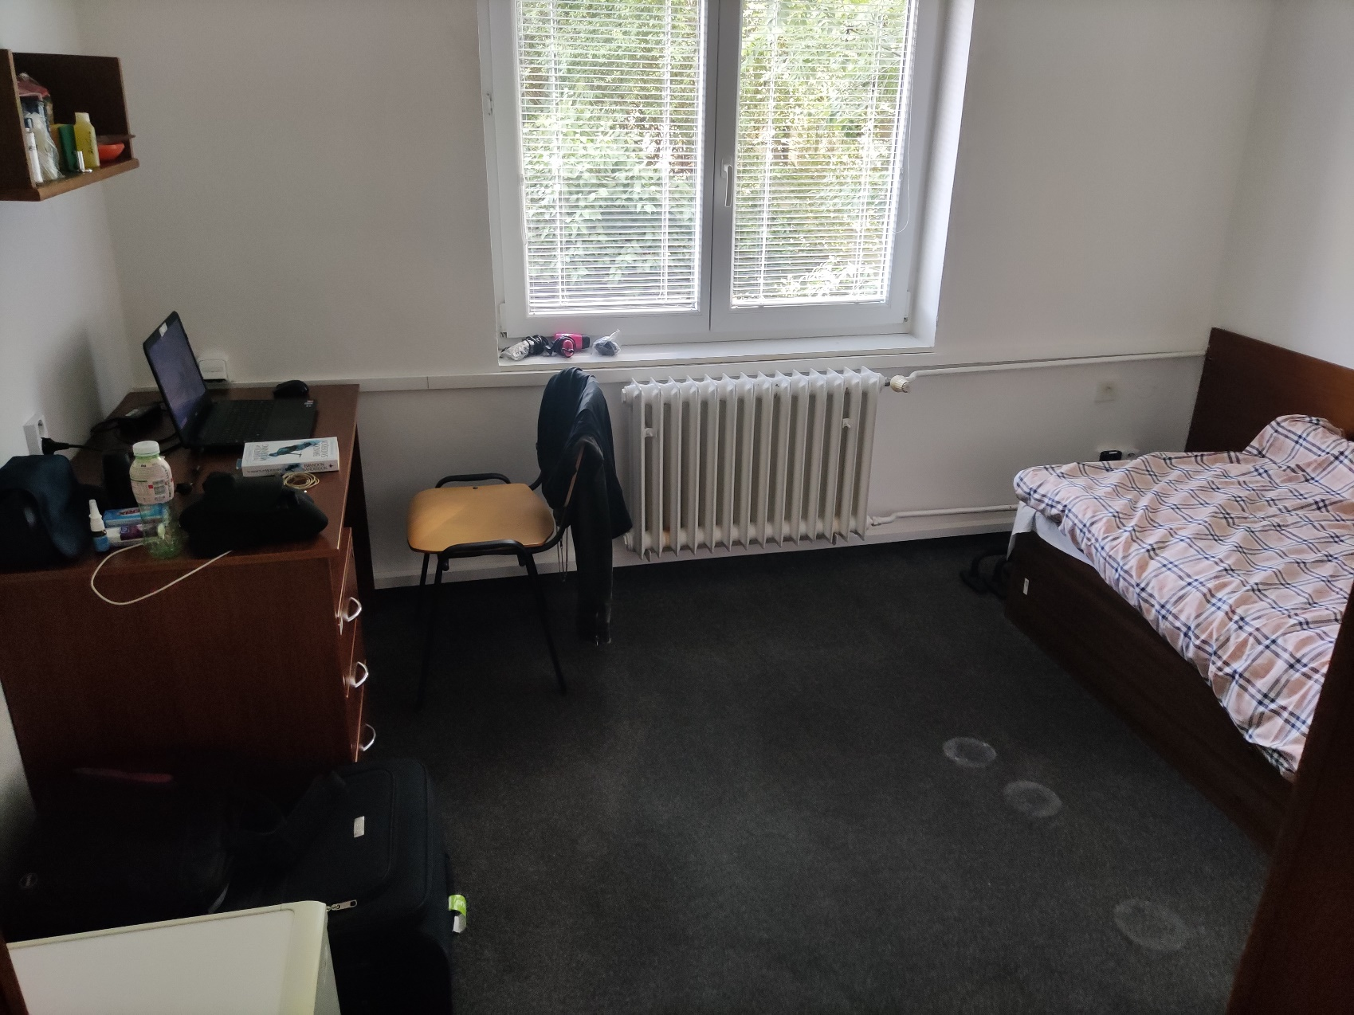
Dolazak u mesto boravka
Arrival at the place of accommodation

Slide 4
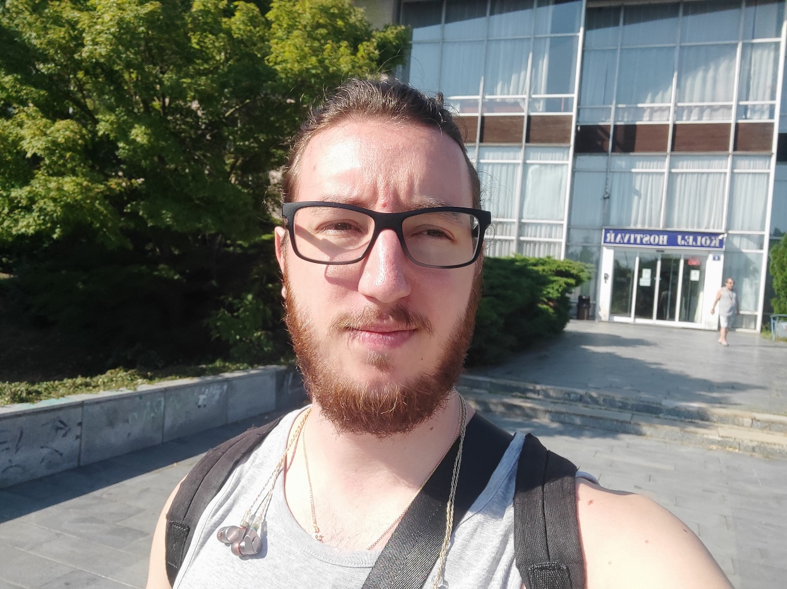
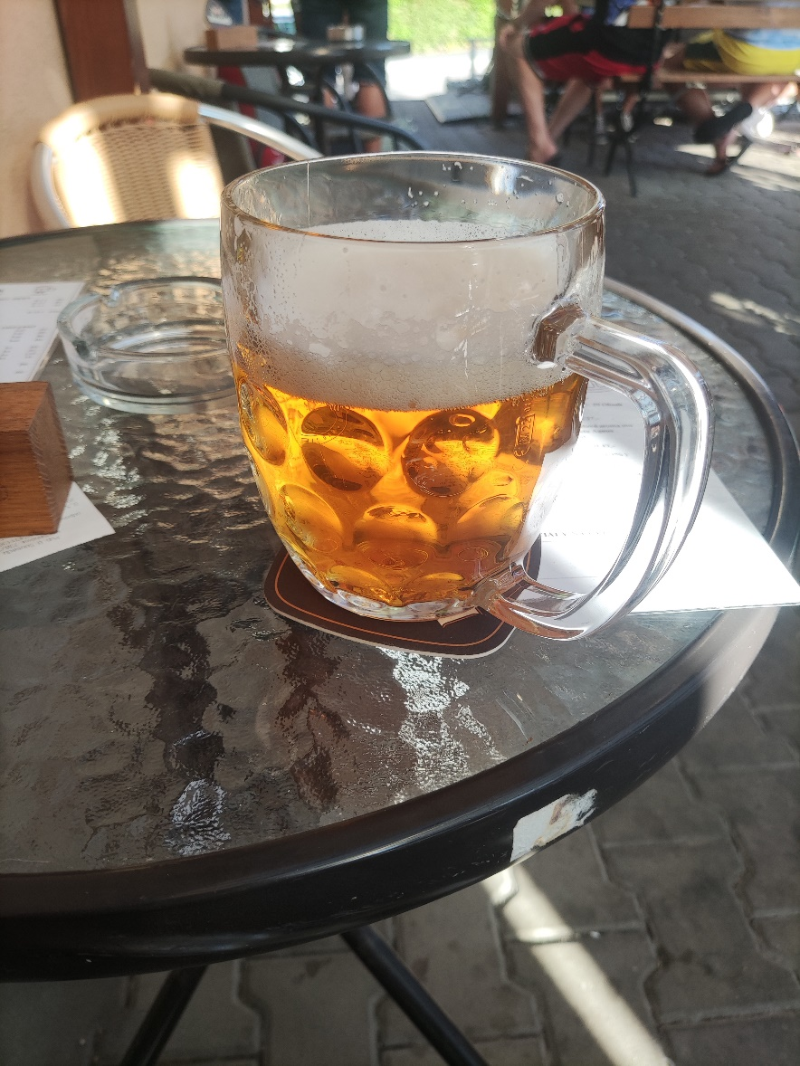
Dolazak u mesto boravka
Arrival at the place of accommodation

Slide 5
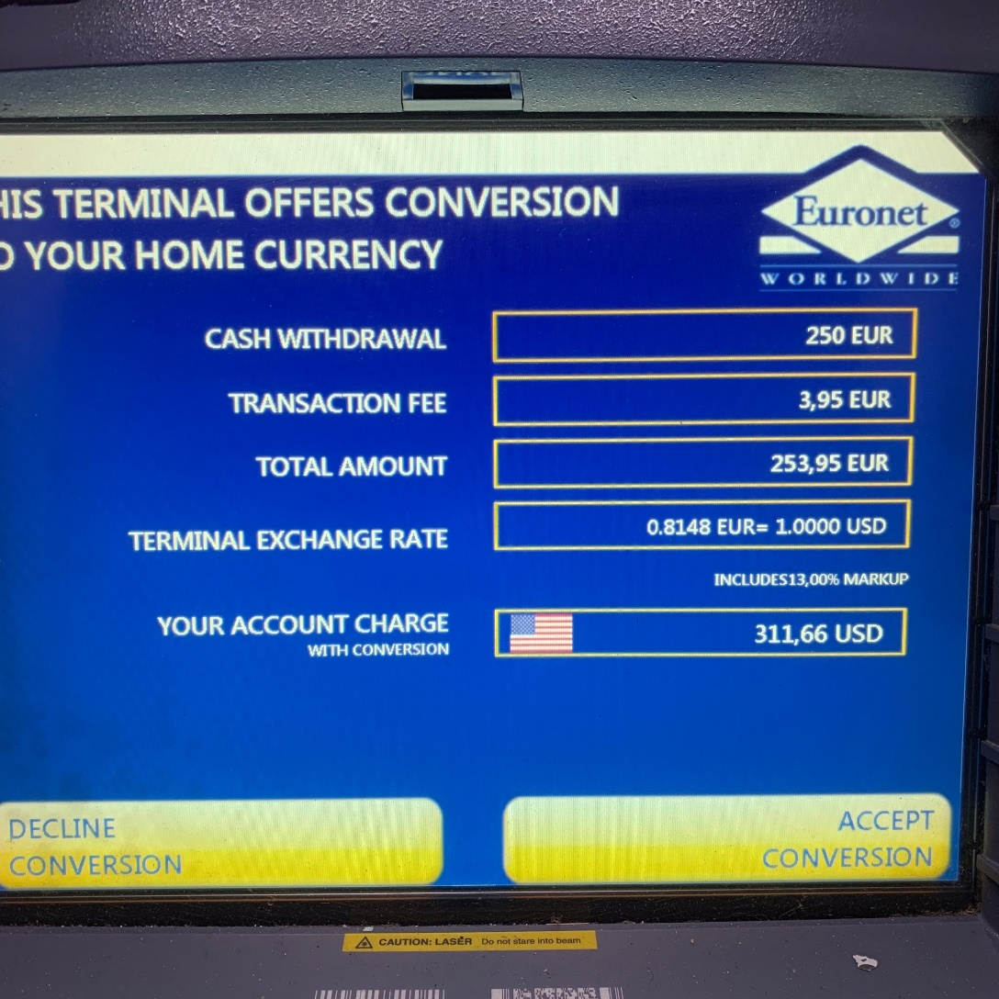
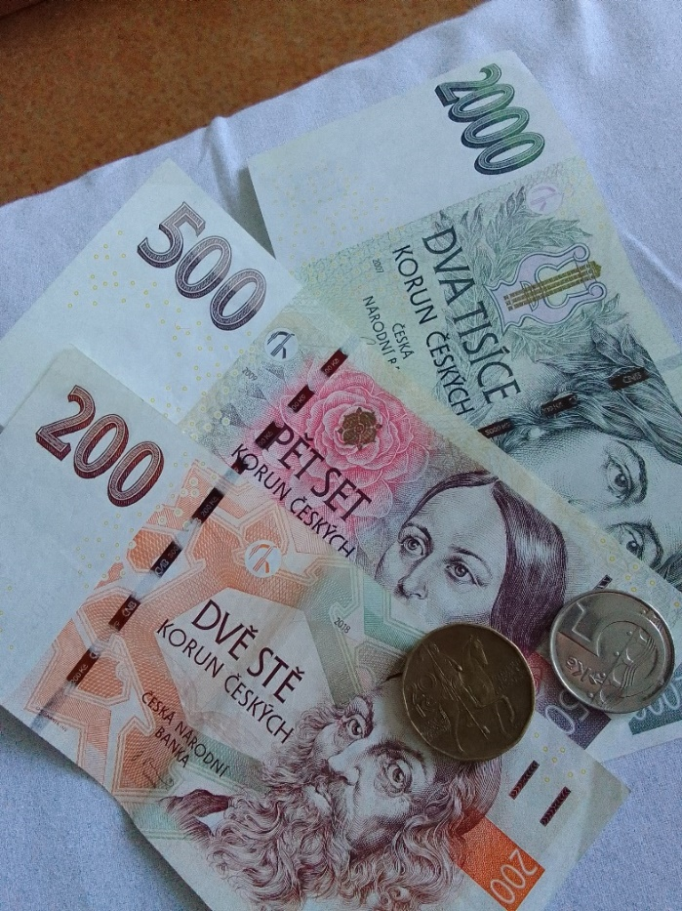
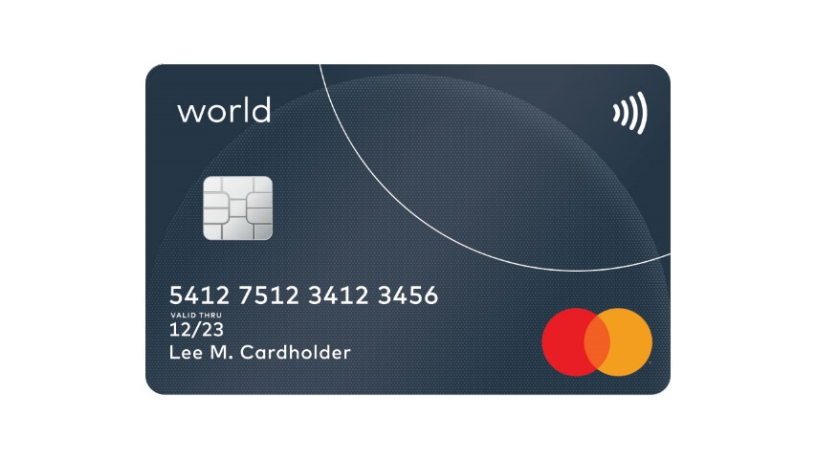
Plaćanja, menjanje novca, bankomati
Paying, money exchange, ATM-s

Slide 6
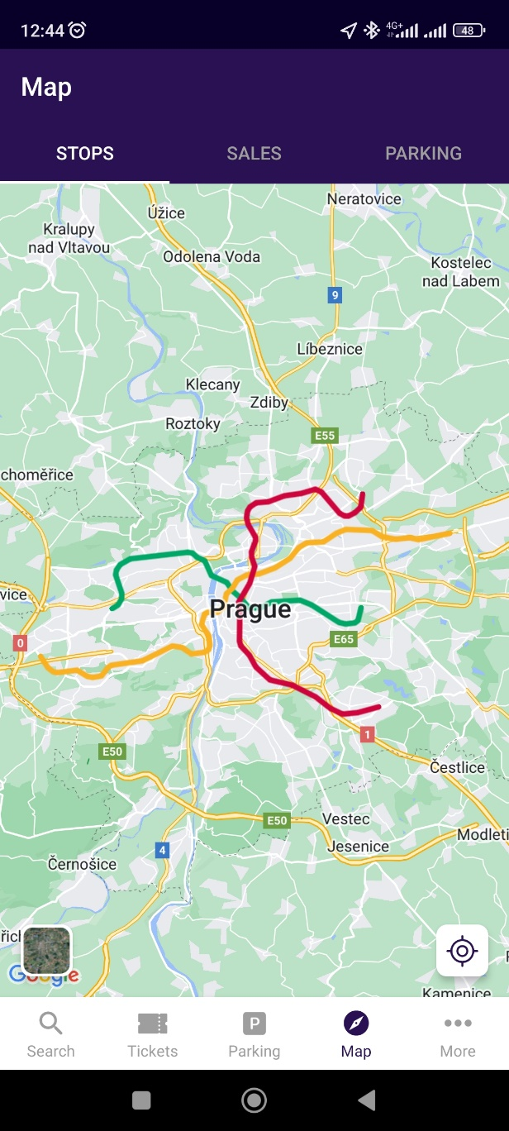
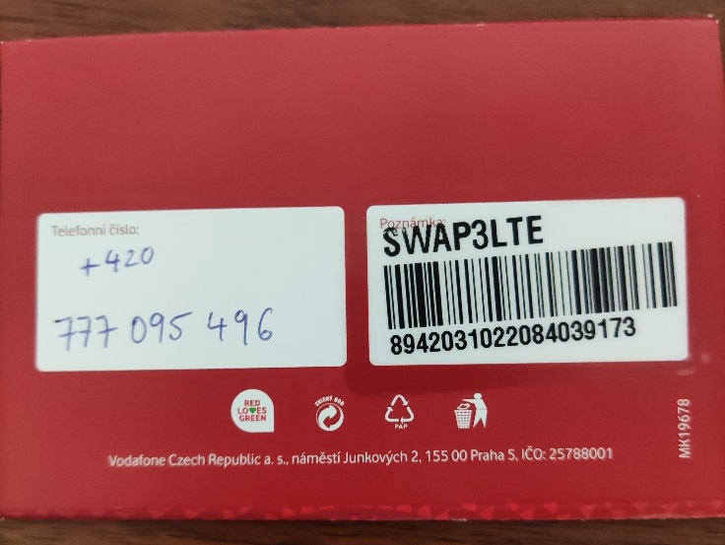

Što pre srediti
Things to do ASAP
Kartica za telefon / Internet
Karta za prevoz i mape
Aplikacije

Slide 7
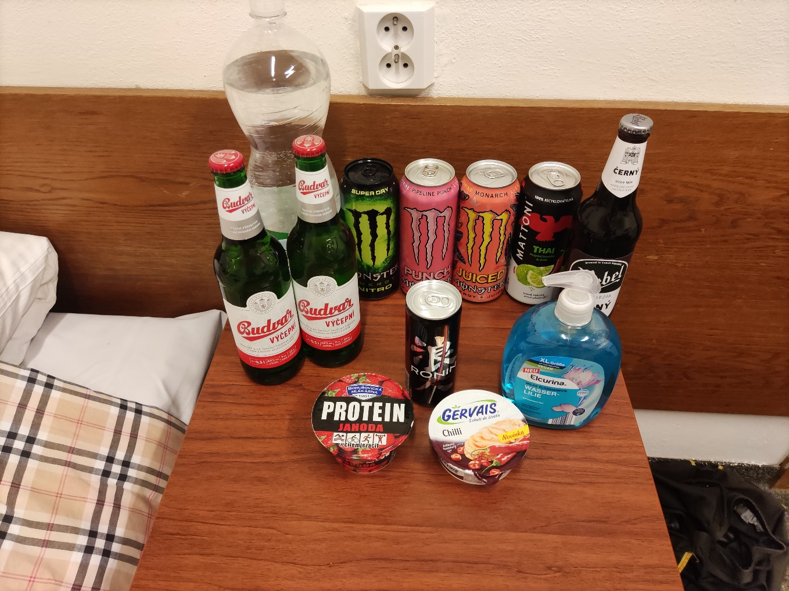
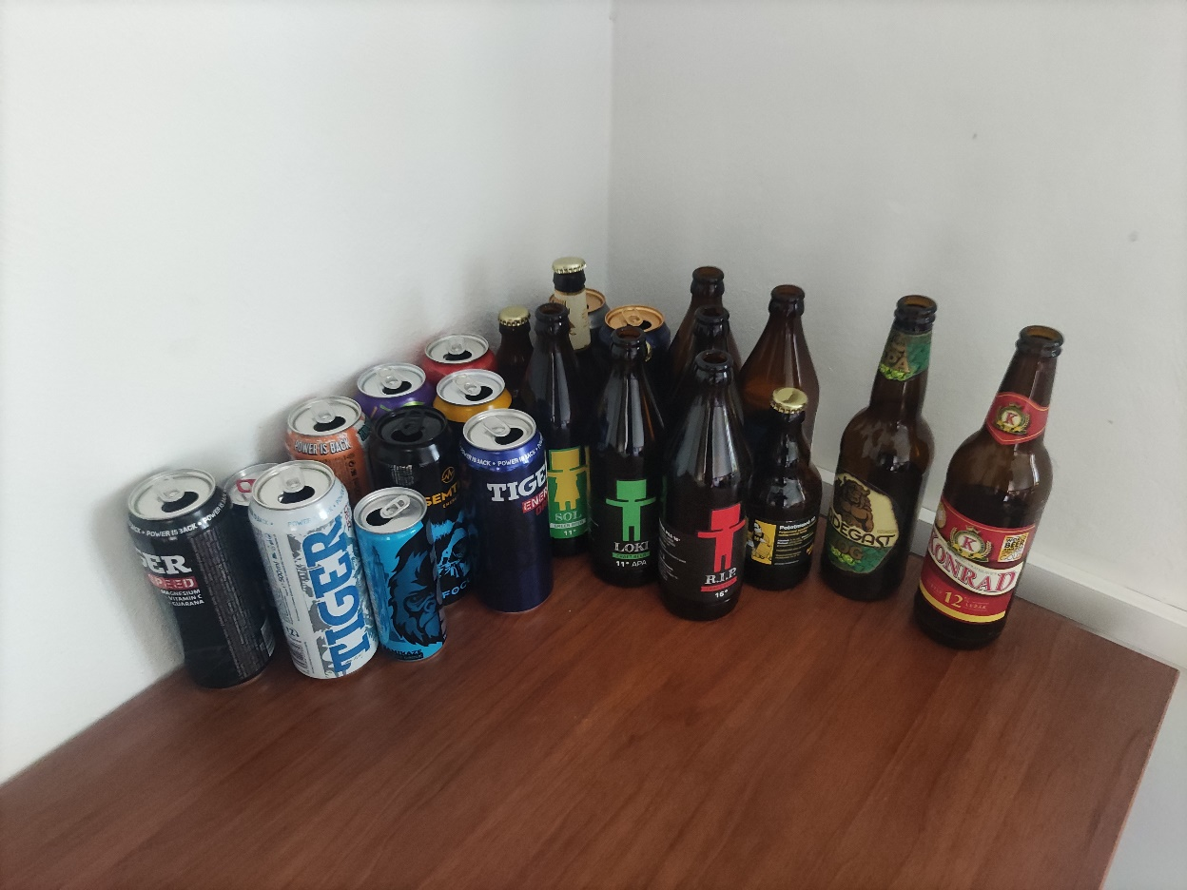
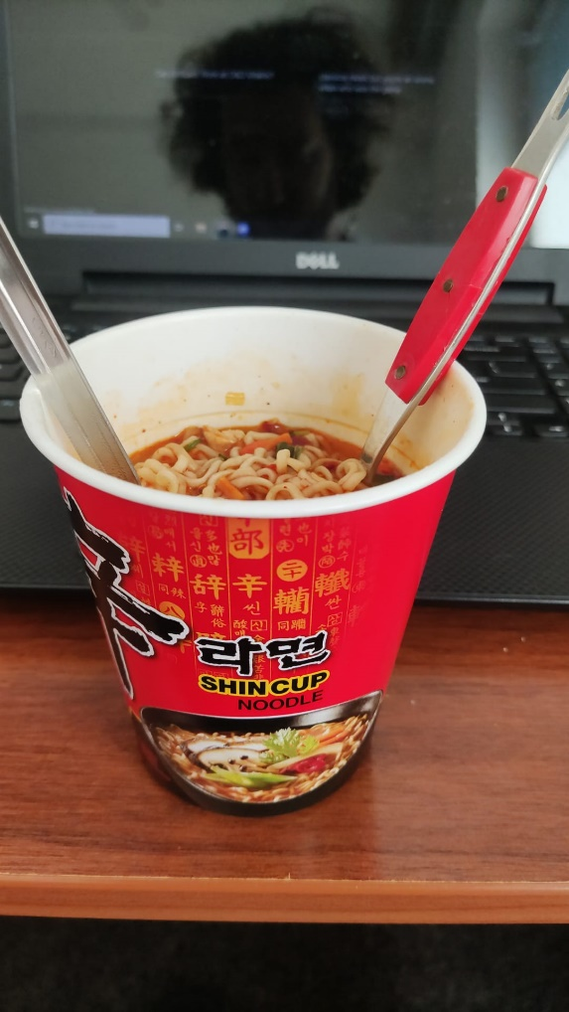
Studentska potrošačka korpa
Students shopping list

Slide 8
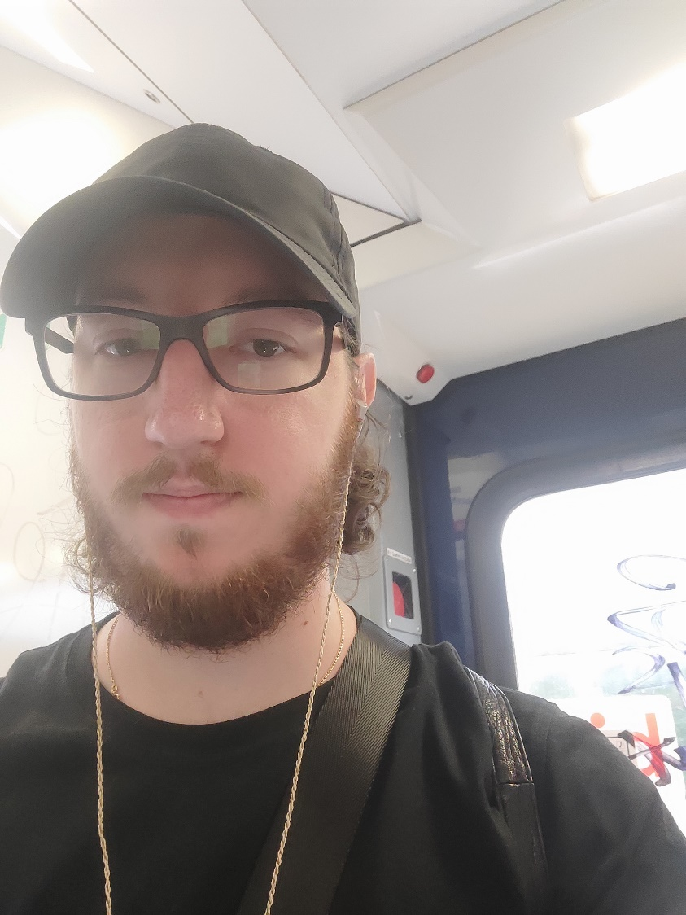
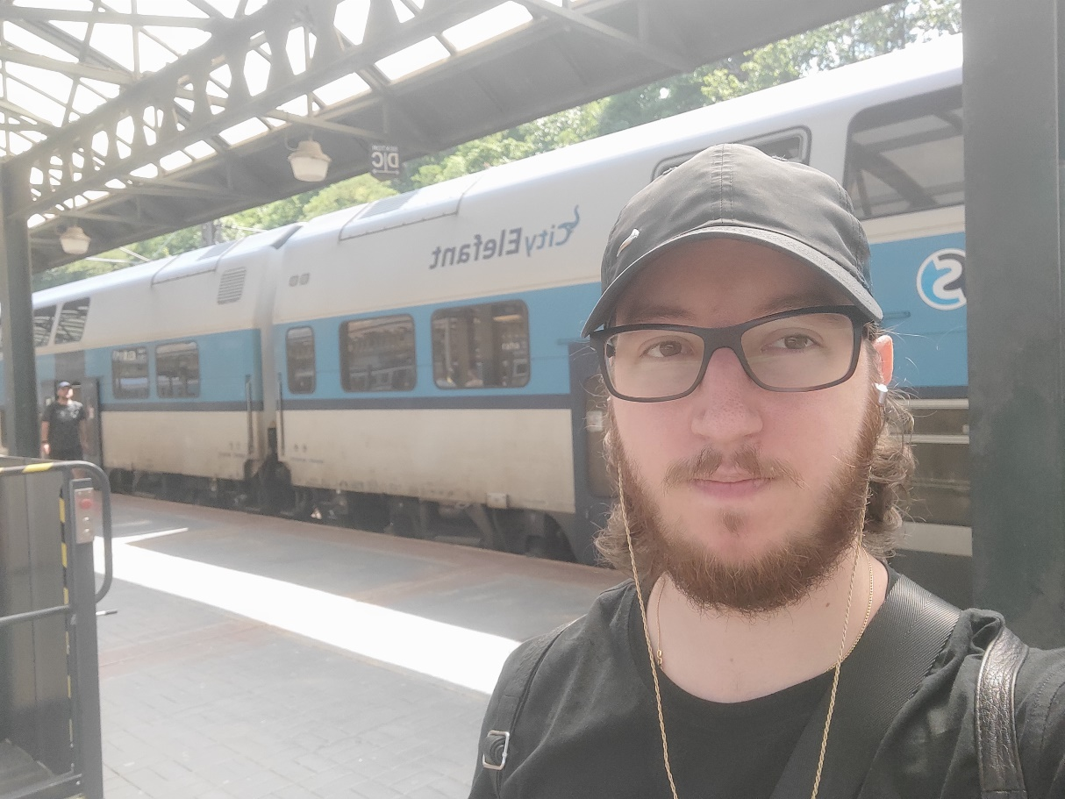
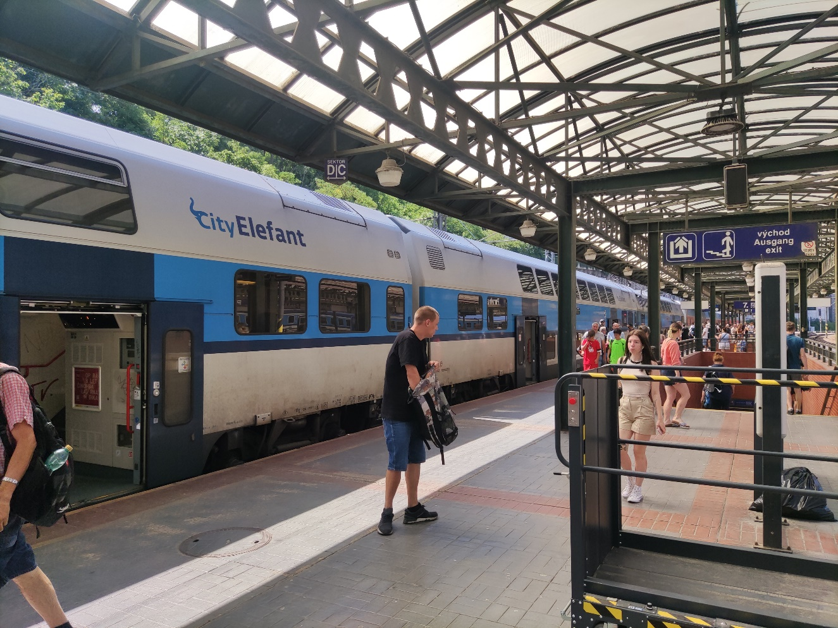
Gradski prevoz
City transportation

Slide 9
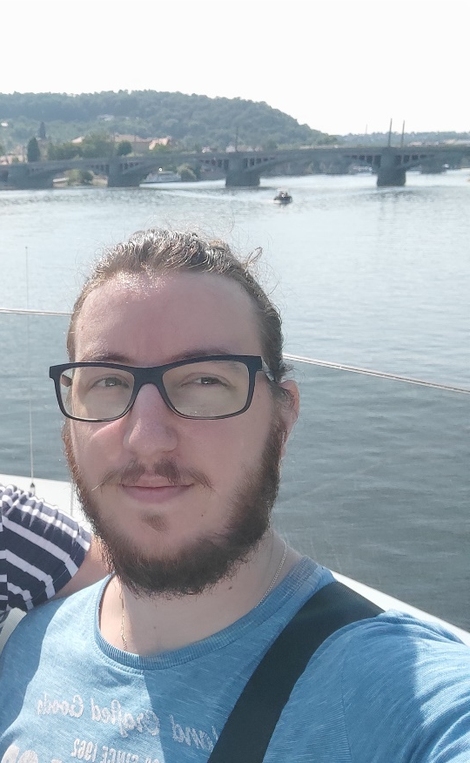
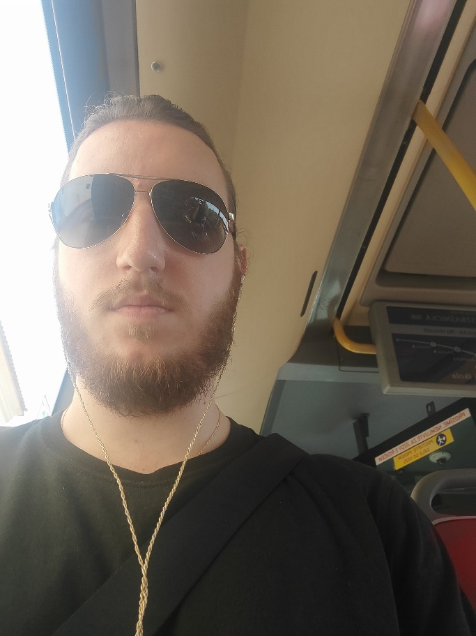
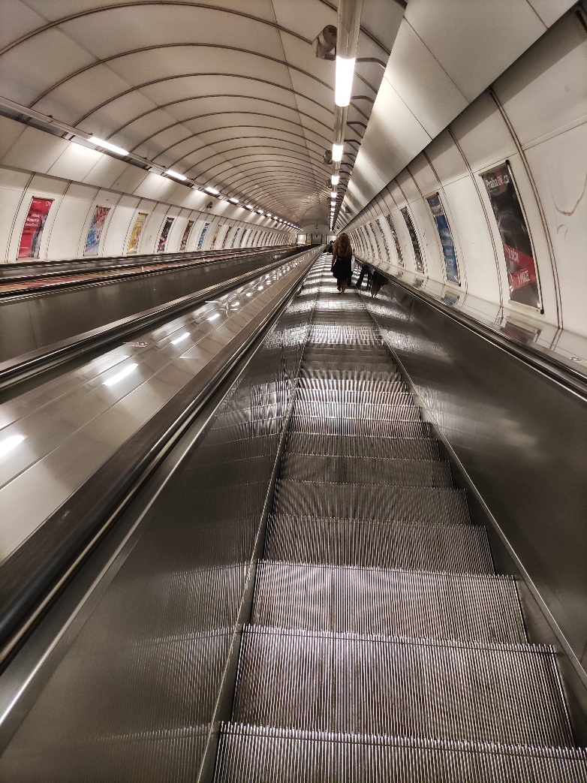
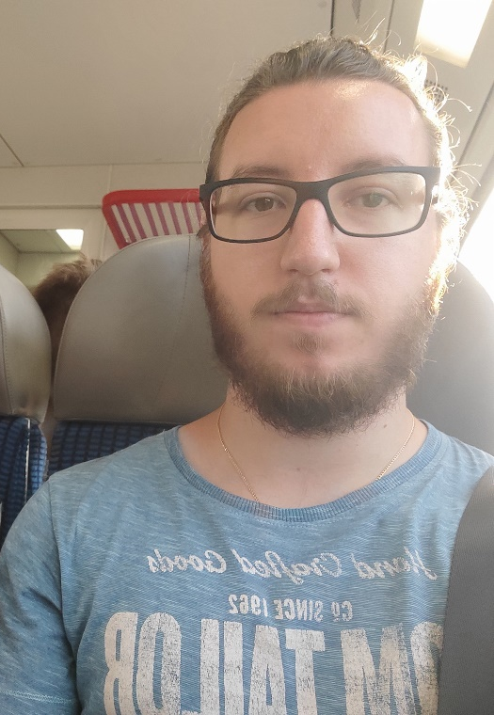
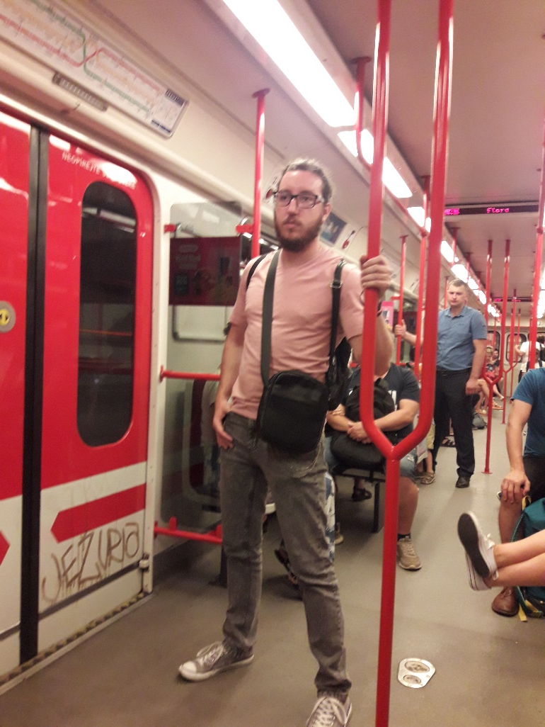
Gradski prevoz
City transportation

Slide 10
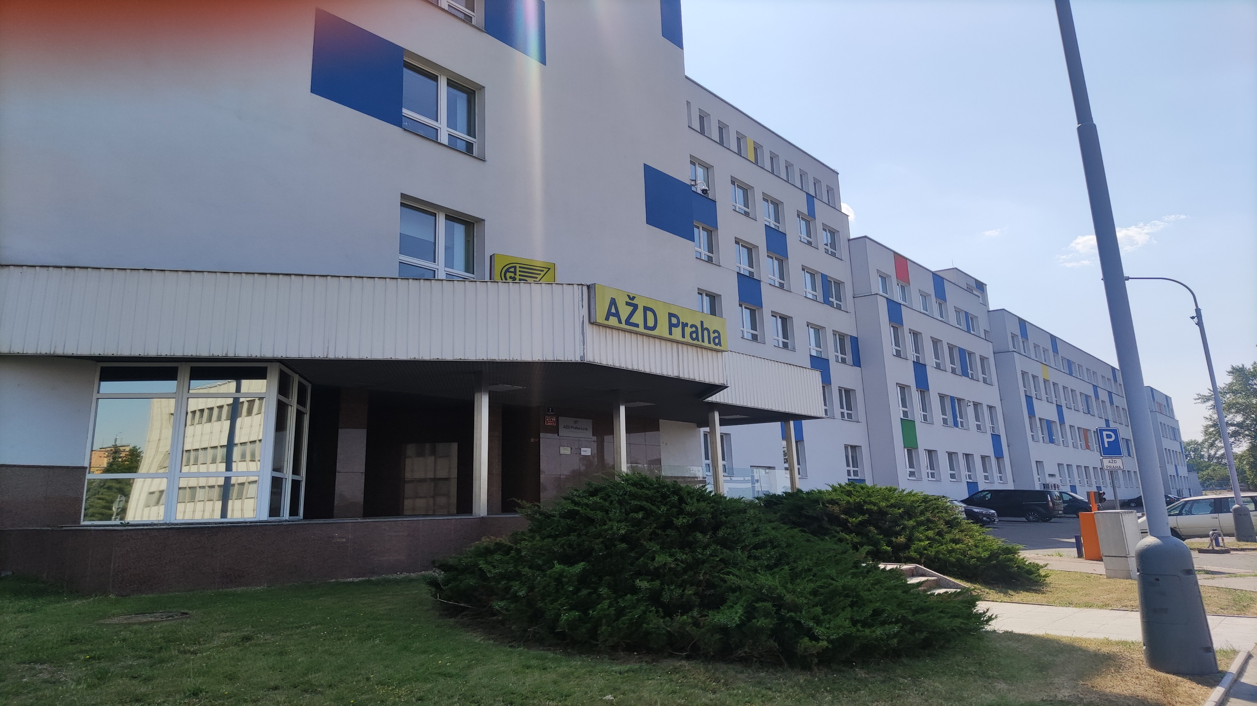
AŽD Praha
We have only just begun

Slide 11
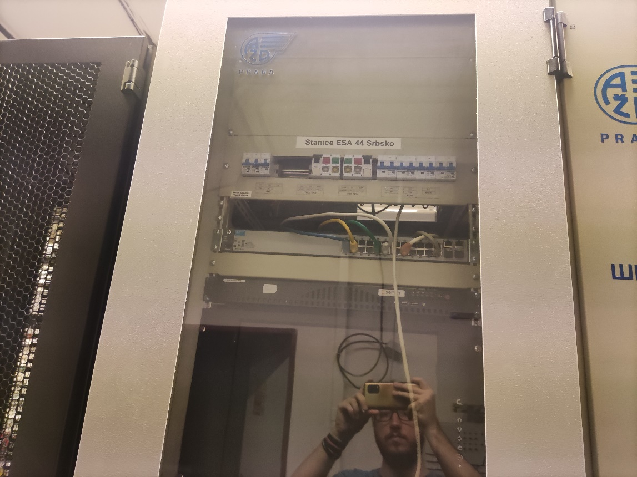
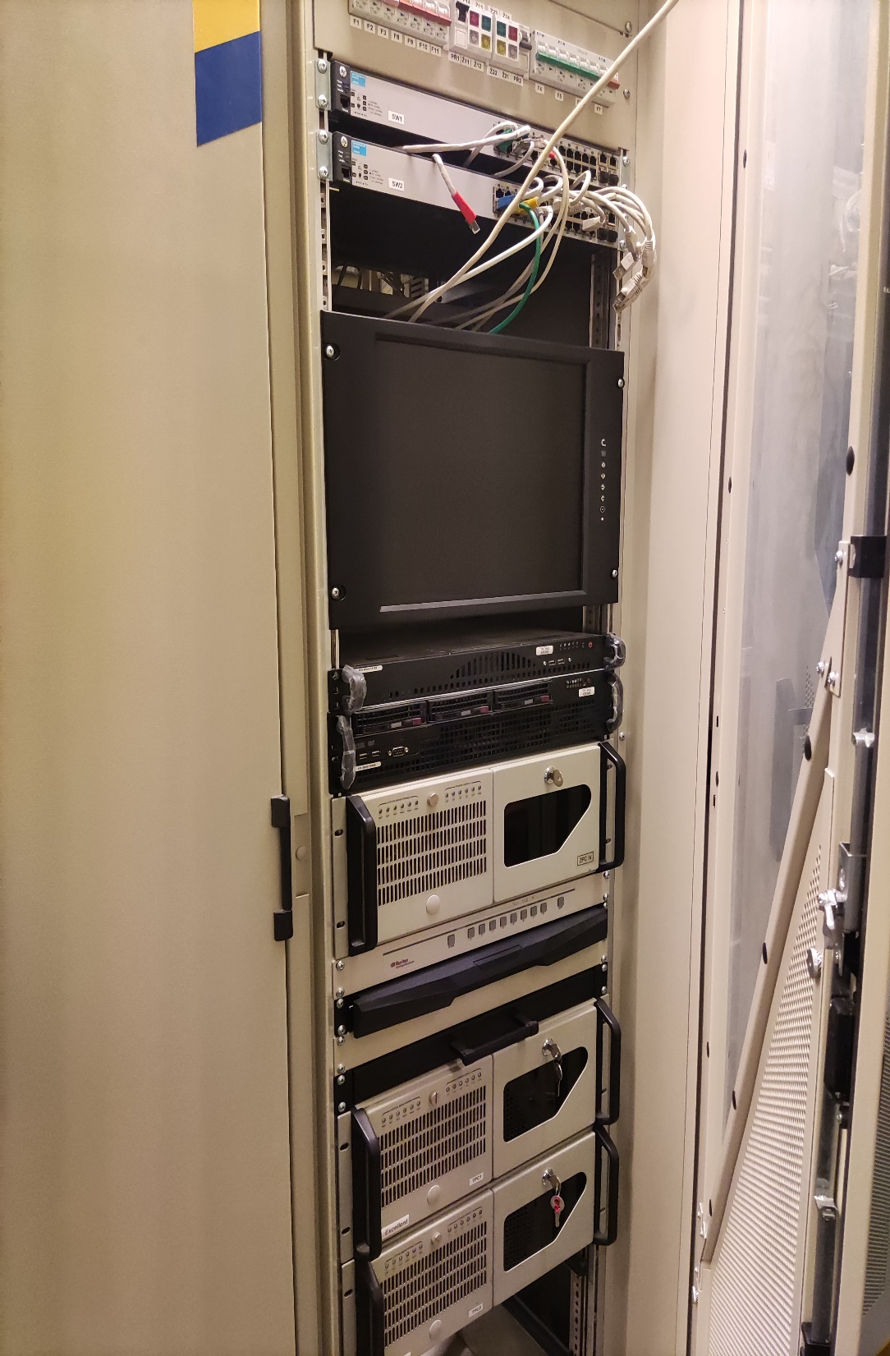
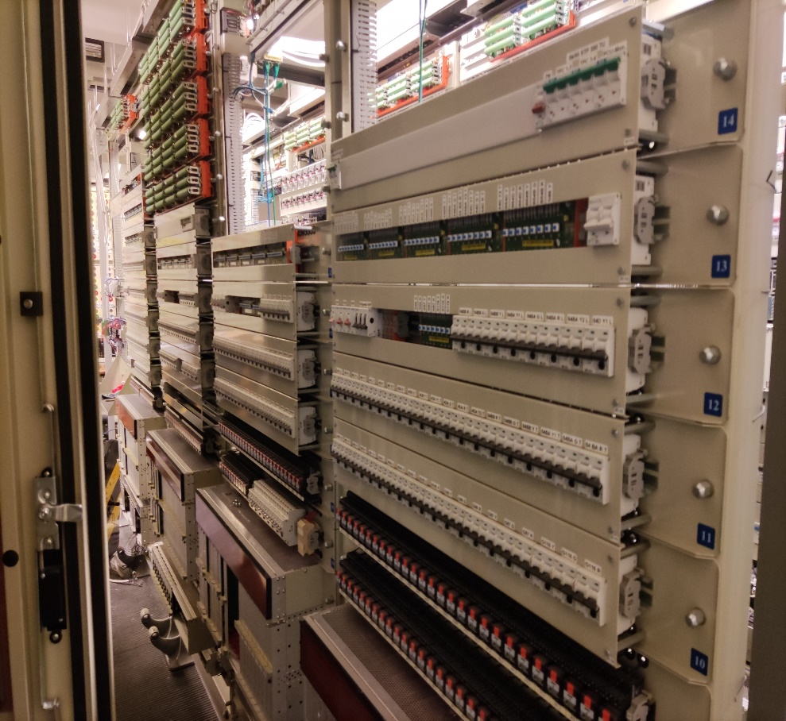
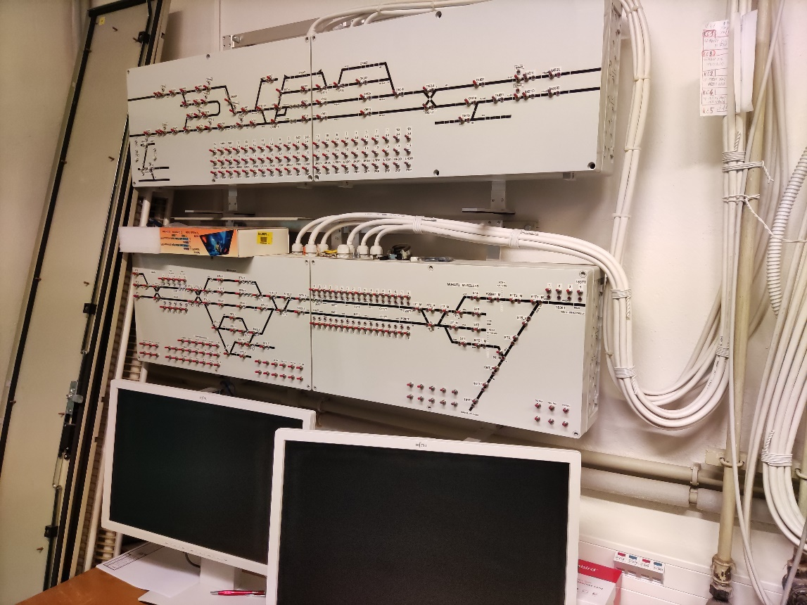
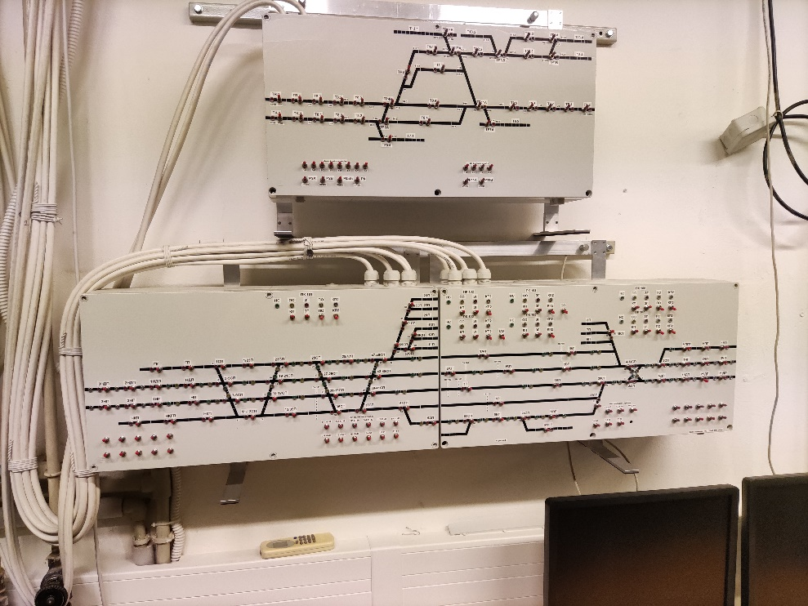
Obilazak kompanije
Tour of the company

Slide 12
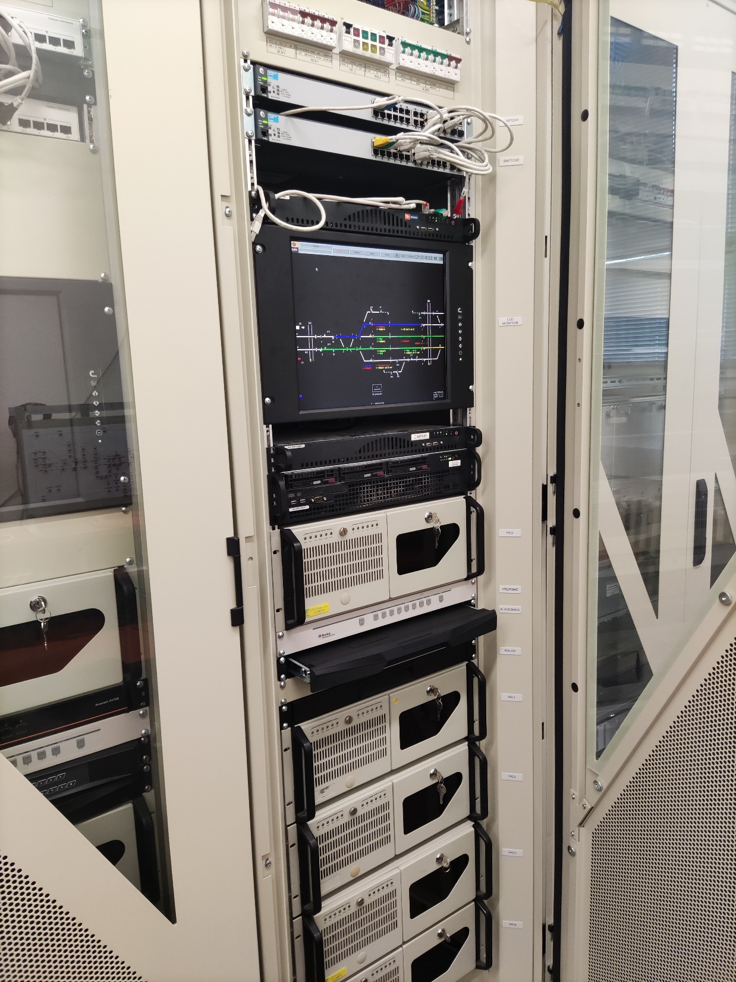
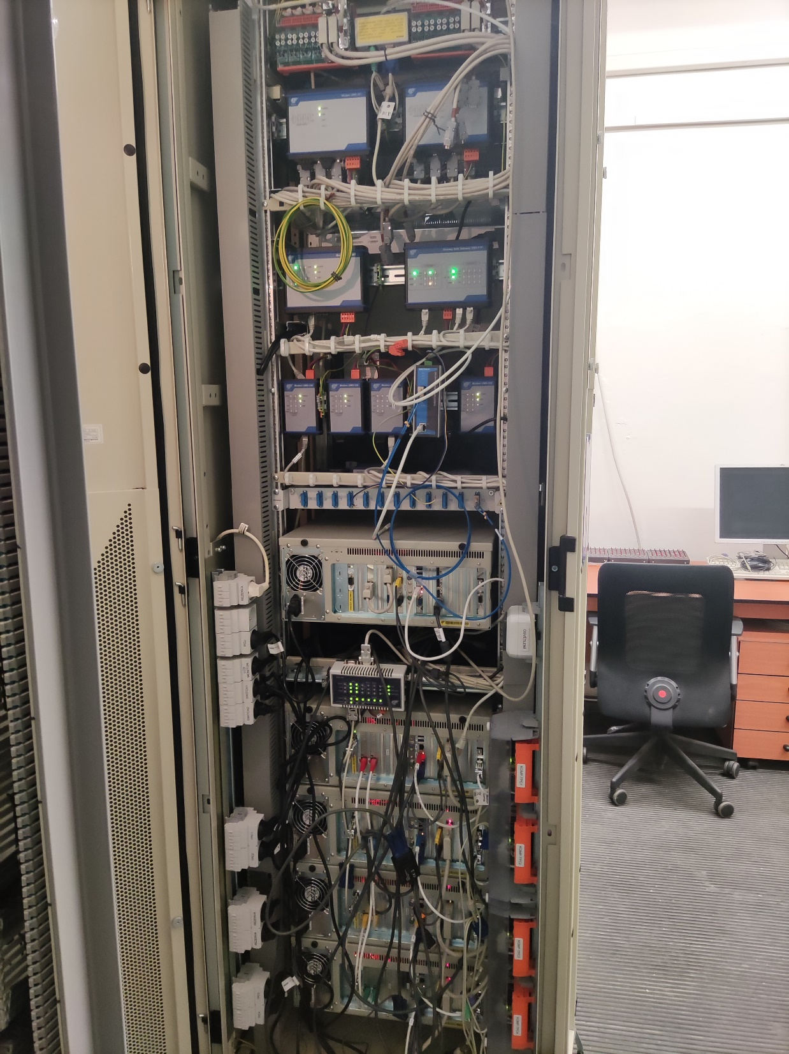
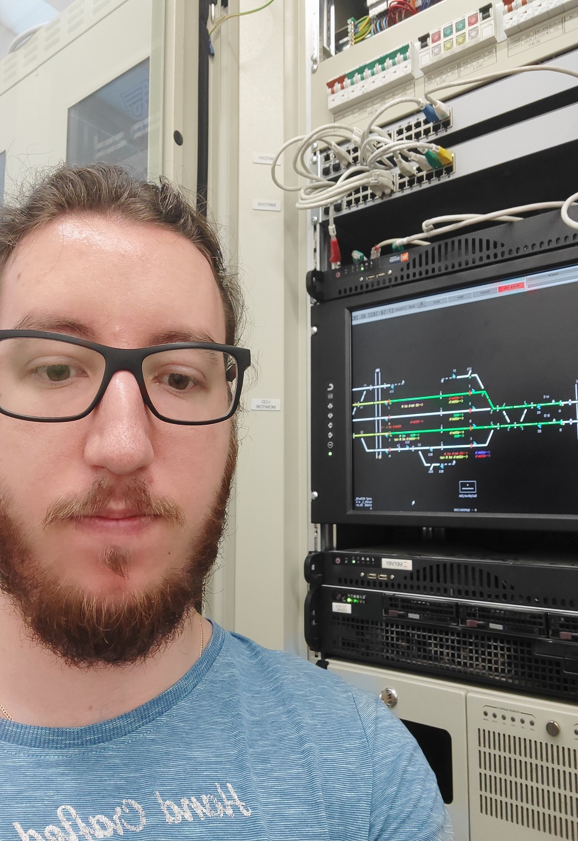
Obilazak kompanije
Tour of the company

Slide 13
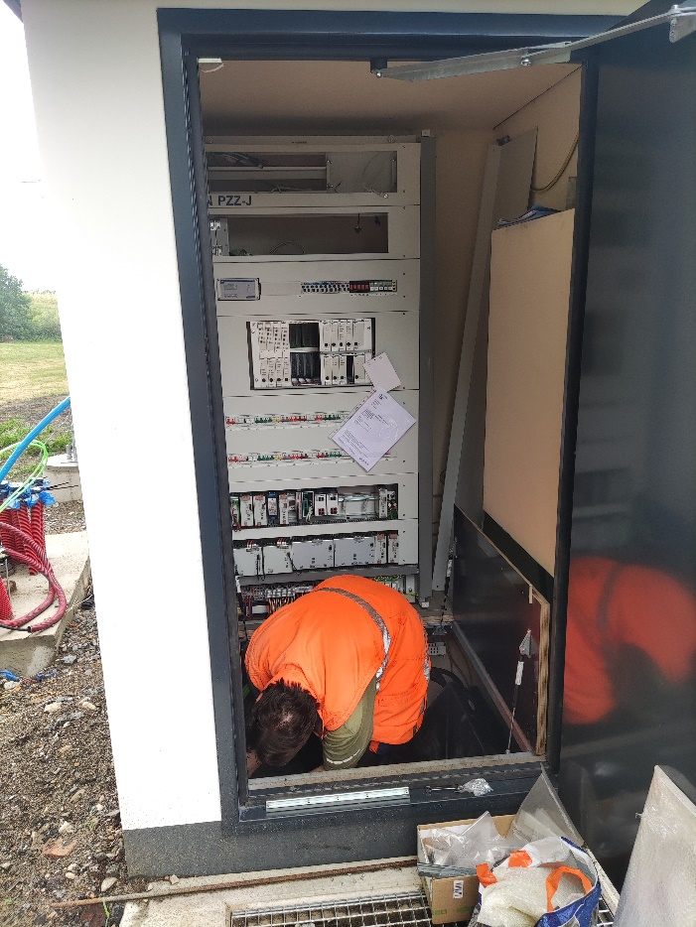
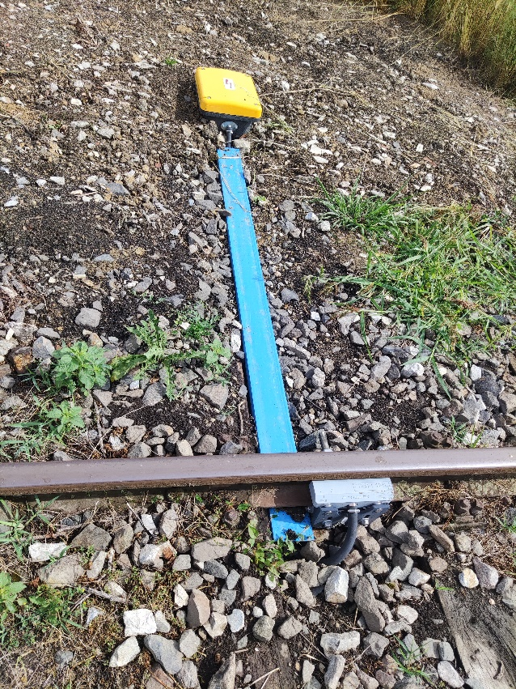
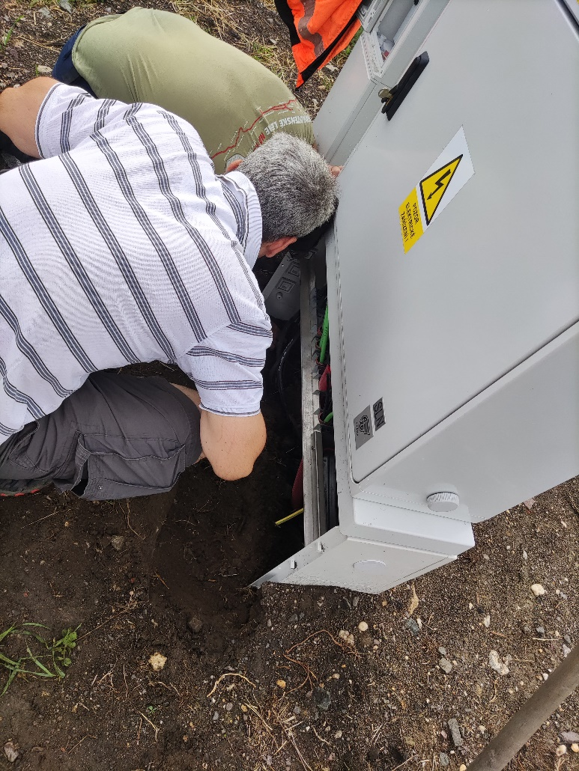
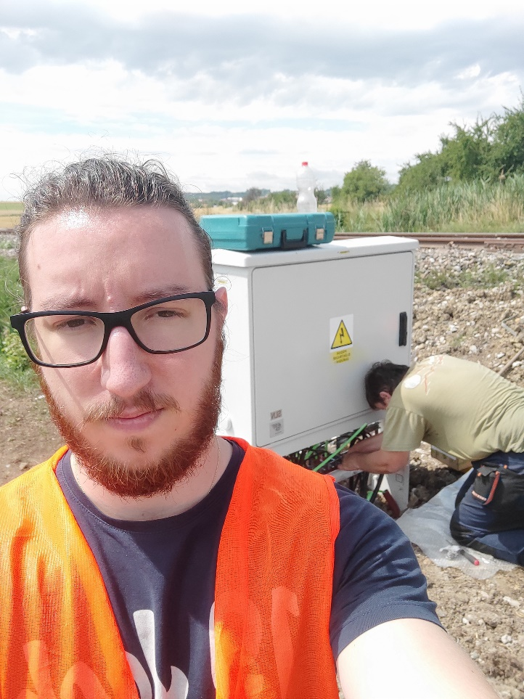
Izlazak na teren
Out in the field

Slide 14
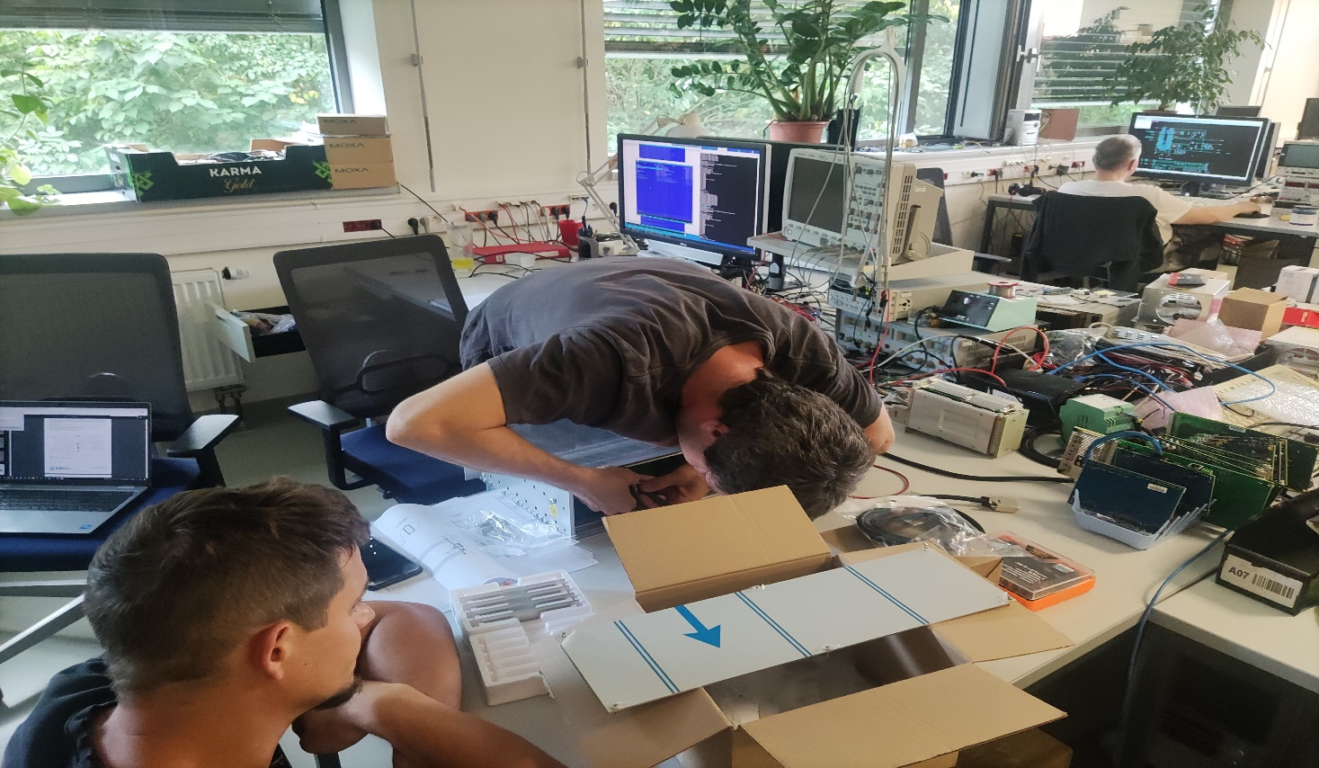
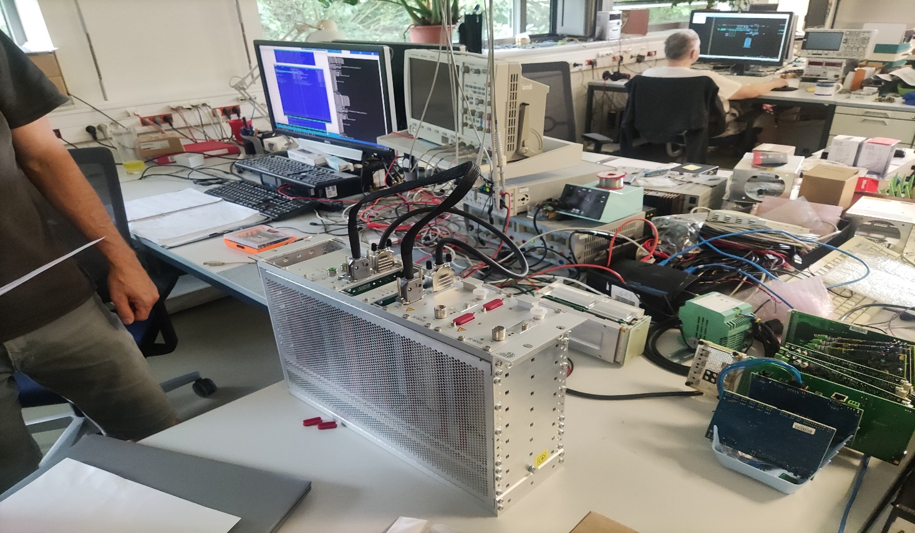
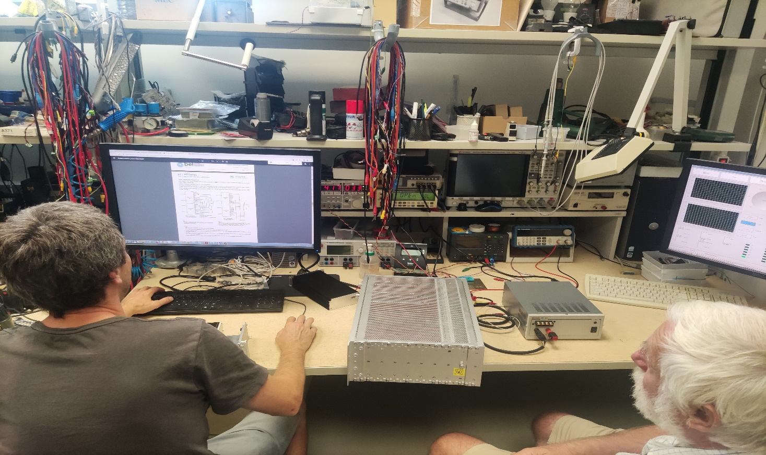
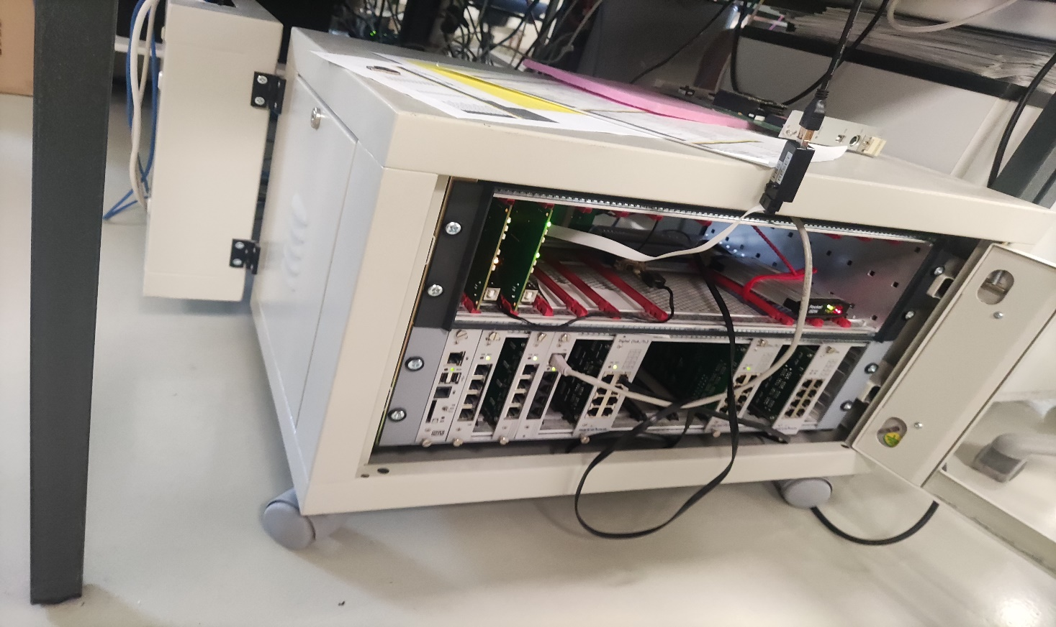
Popravke i dijagnostika
Repairs and diagnostics

Slide 15
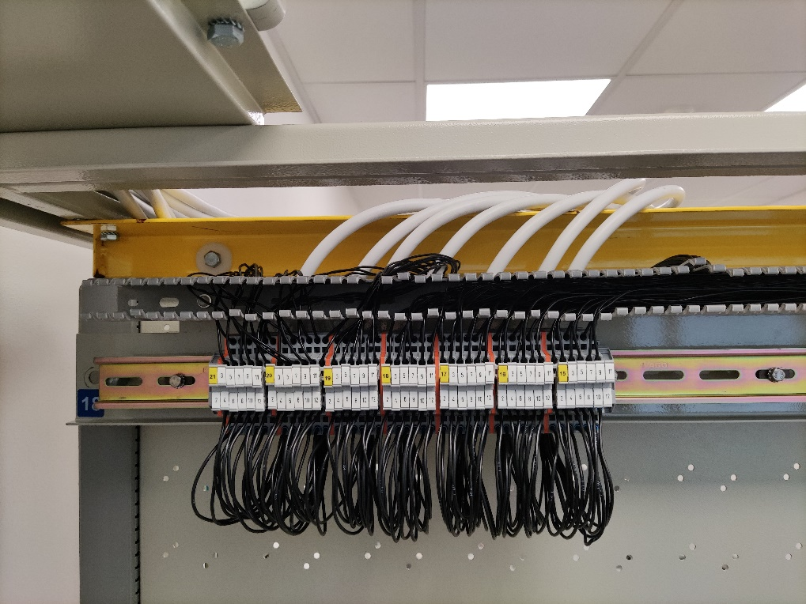
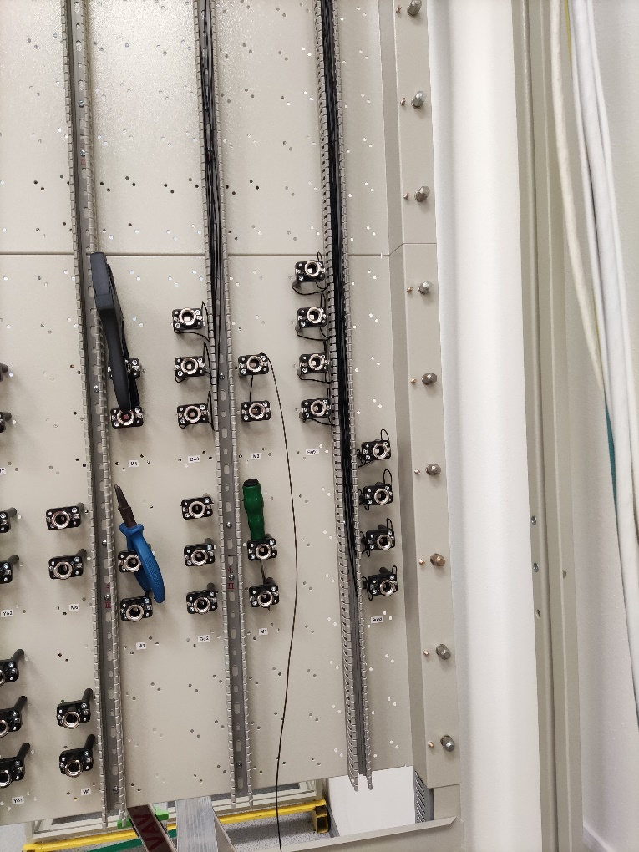
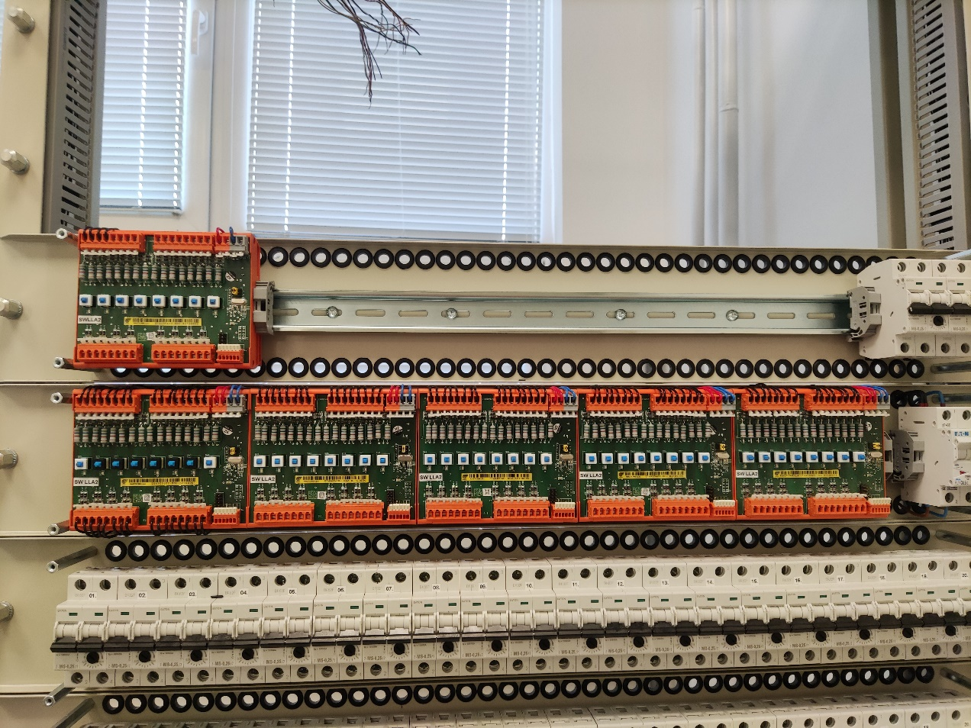
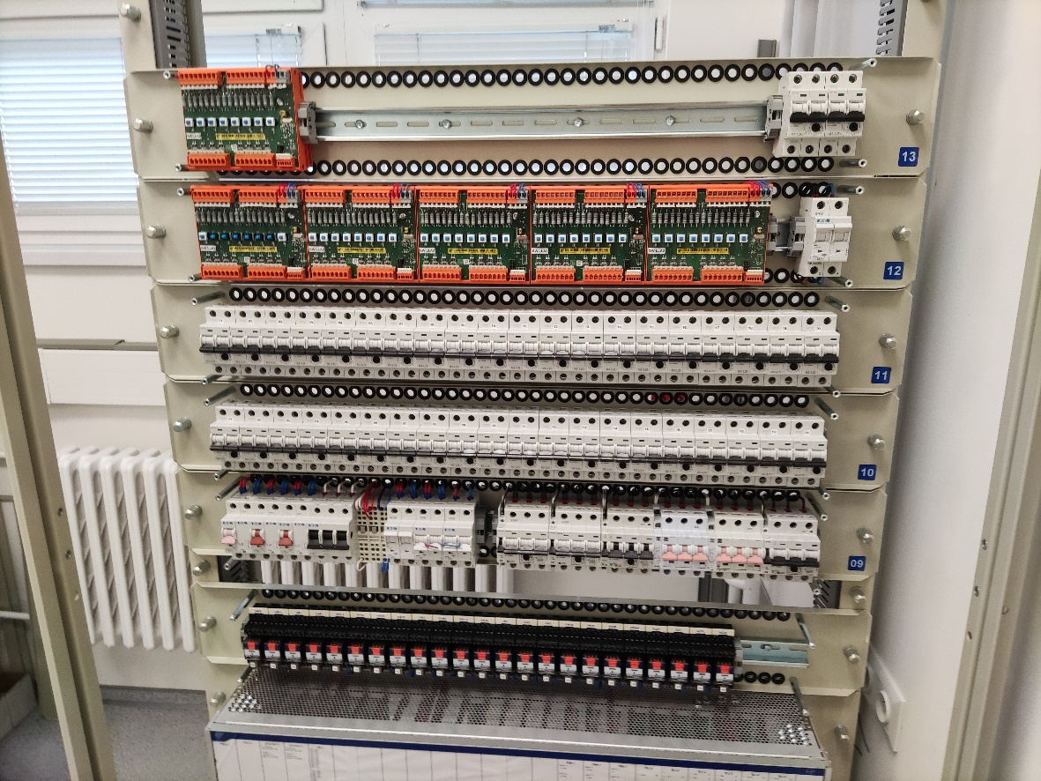
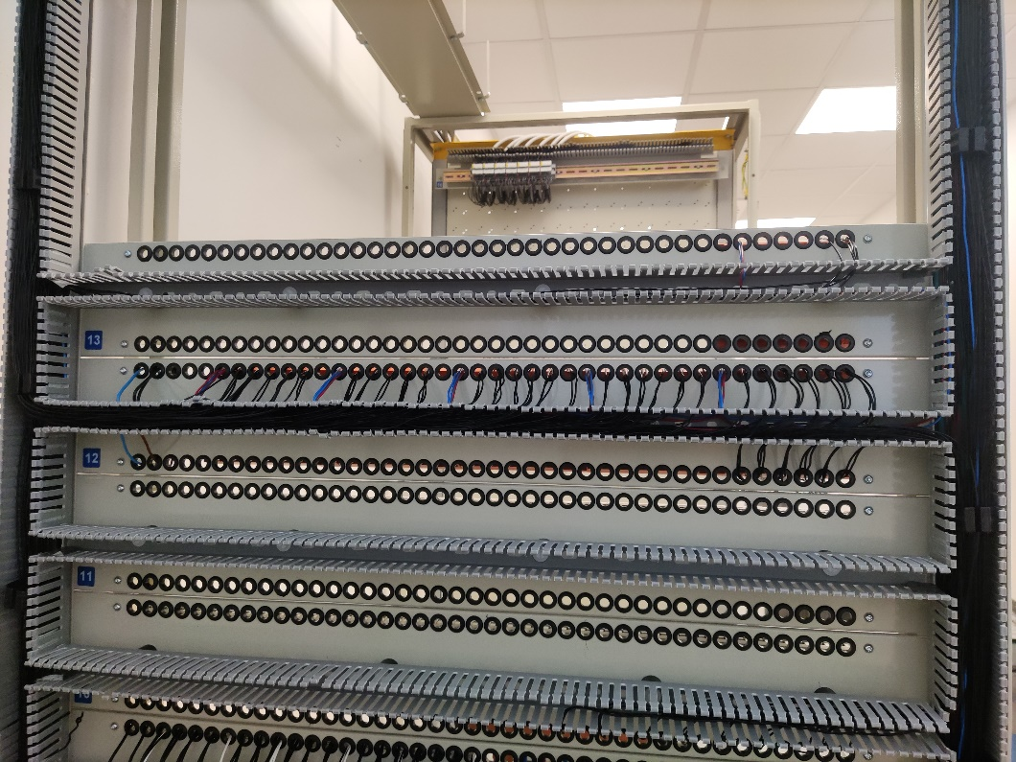
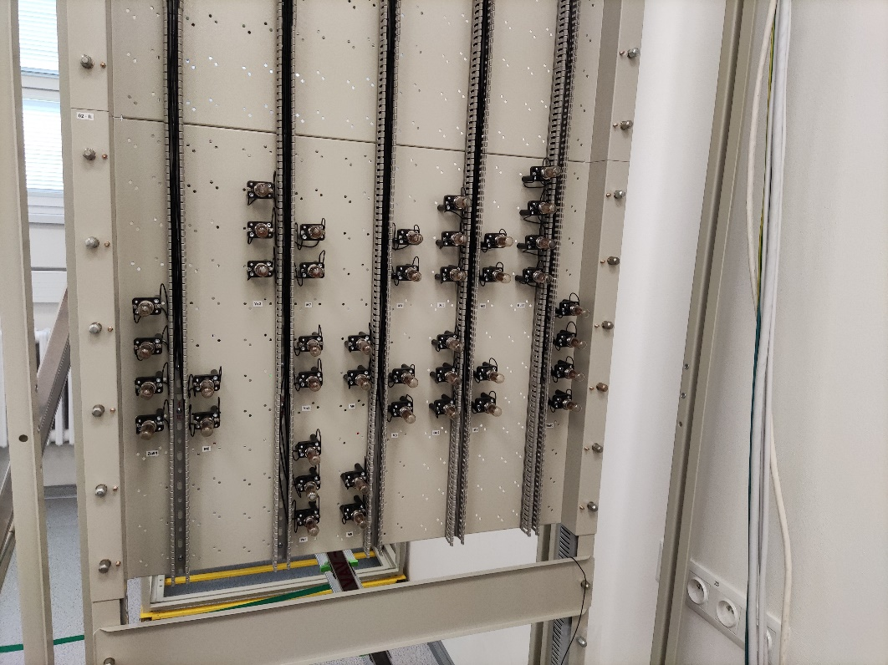
Poligon
Do it yourself

Slide 16
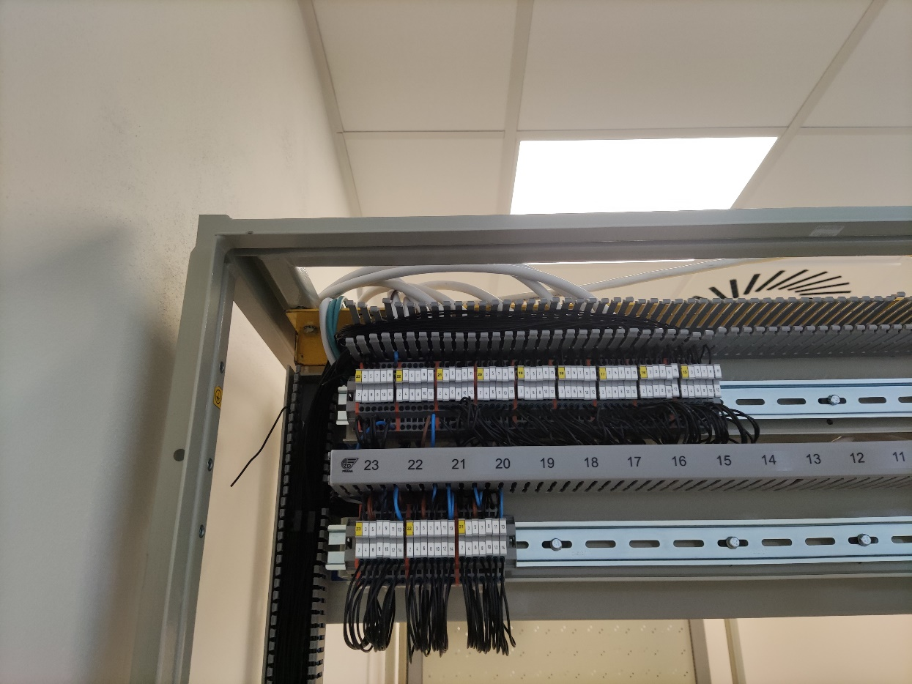
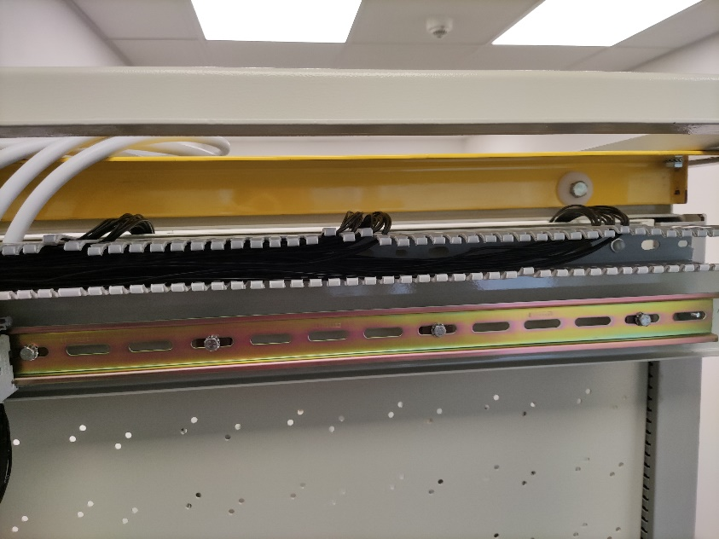
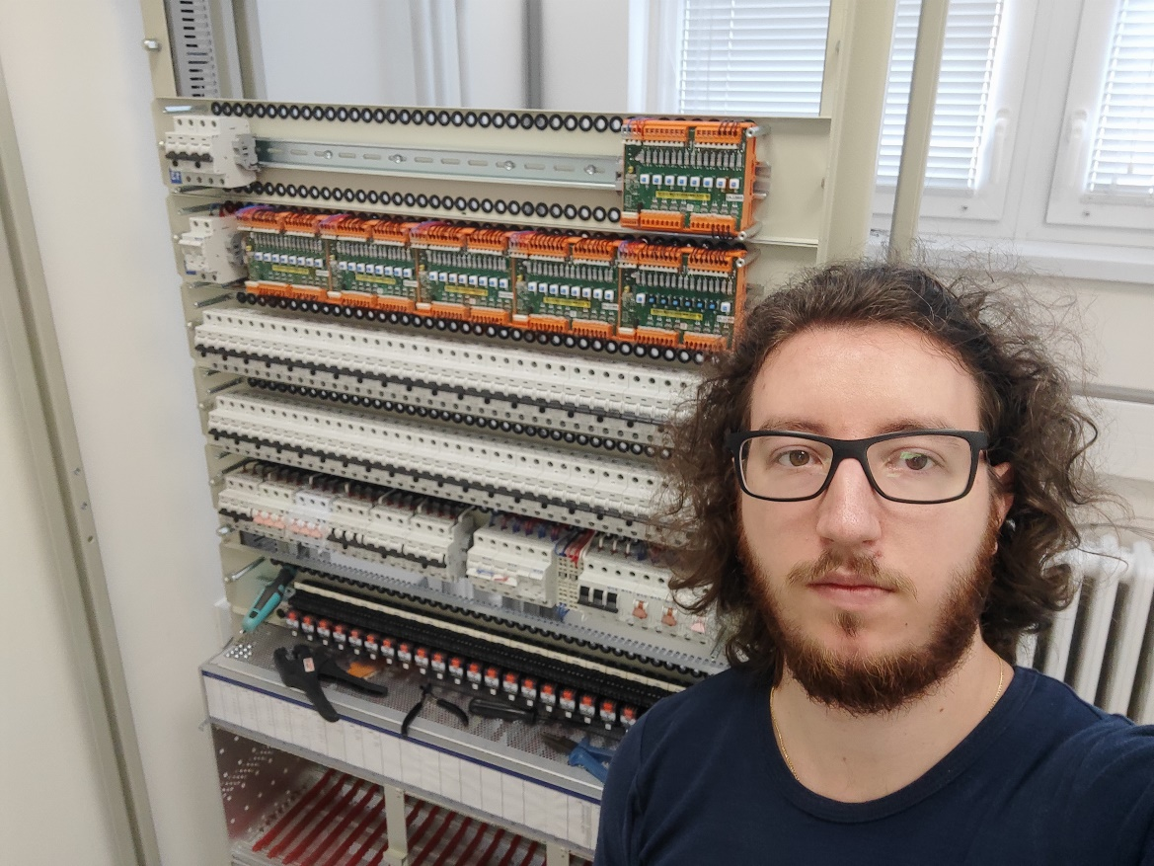
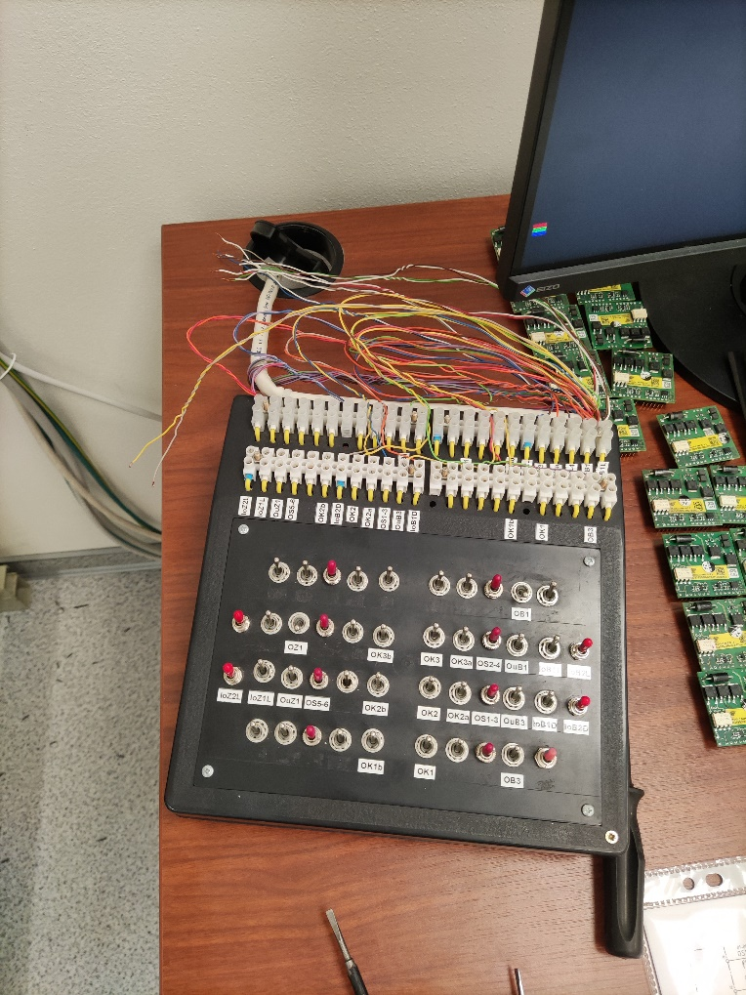
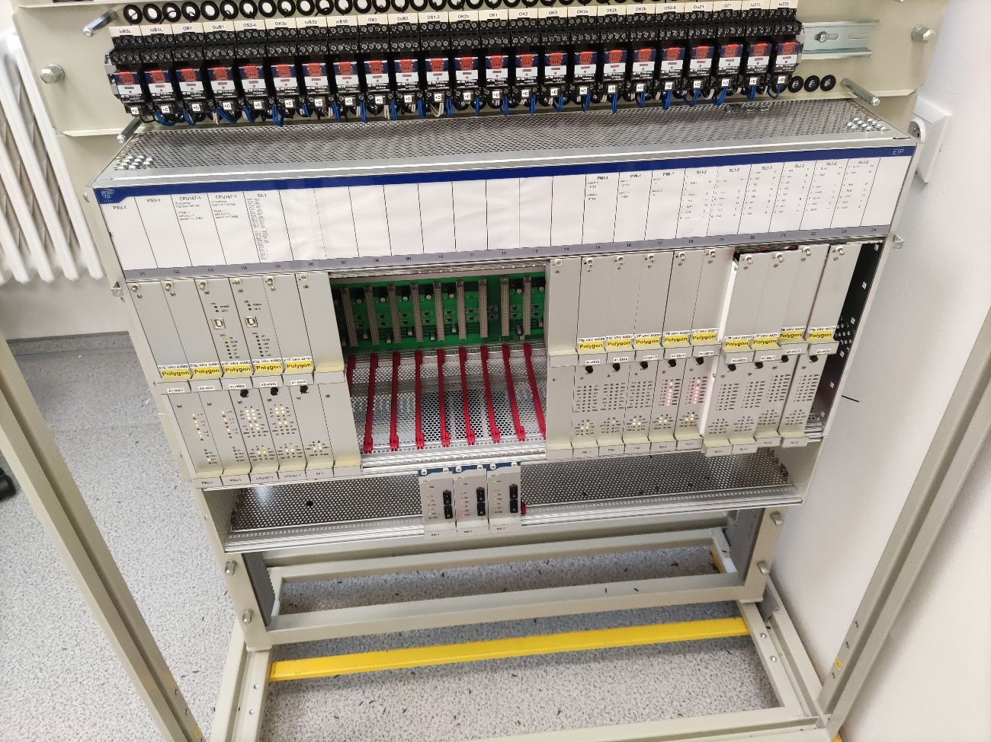

Poligon
Do it yourself

Slide 17


Poligon
End product

Slide 18





Pruga za vozove bez vozača – u pripremi
Driverless track – work in progress

Slide 19



Poseta CDP-u
Visit to CDP

Slide 20



Poseta CDP-u
Visit to CDP

Slide 21




Poseta CDP-u
Visit to CDP

Slide 22



Poseta CDP-u
Visit to CDP

Slide 23

Računarsko odeljenje, GSM-R, projektovanje, simulator
Computer sector, GSM-R, system designing and planing, simulator

Slide 24

Slobodno vreme i obilasci
Free time and tourism

Slide 25

Oppenheimer
Now I am become death, the destroyer of worlds

Slide 26






Prag
Prague

Slide 27






Prag
Prague

Slide 28








Prag
Prague

Slide 29





Prag
Prague

Slide 30

Prag
Prague

Slide 31







Budimpešta
Budapest

Slide 32



Sziget festival
Budapest

Slide 33








Brno
Brno

Slide 34





Hrana
Food

Slide 35





Hrana
Food

Slide 36








Pivo
Beer

Slide 37



Pivo
Beer

Slide 38







Pravdanje troškova
Got to keep tabs on how much you drink

Slide 39

Hvala na pažnji
Thanks AŽD Praha
Vidimo se uskoro, ako išta bar na pivu
See you soon, if anything to get some beer

