Slide 1



ERASMUS DAYS 2023 IS ON!
Welcome!
VREME:
SREDA, 18.10.2023. god., 17 -19 časova
MESTO:
Sala desno Odseka VIŠER (prizemlje)
TEMA:
Moj ERASMUS+ pogled

Slide 2



Autumn Tech School
Blended Intensive Program
Date & Place: 9 – 13 October 2023 / Maribor / SLOVENIA
Notes:
Slidesgeek.com

Slide 3

TABLE OF CONTENTS
About us
Welcoming Session
About mobility program
About Povio d.o.o. Company & Challenge
Group work
International Afternoon Event
Attending lectures
Mentors’ daily overview & consultations
Visit to IZUM
Workshops
Exploring Maribor
Pitching session & judging
Certification
Notes:
bruce-mars-8YG31Xn4dSw-unsplash

Slide 4


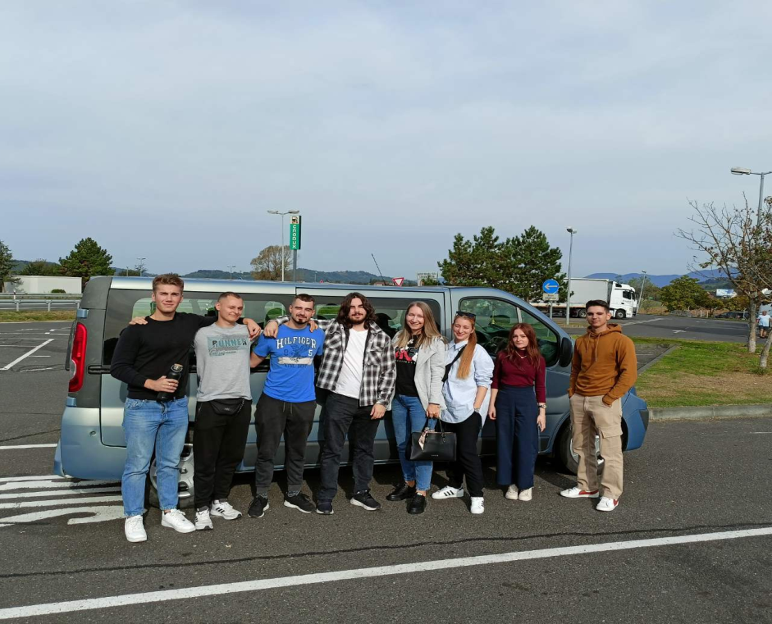
Business Proposal
ABOUT US
The staff members:
prof. dr Zoran Lovreković
prof. dr Doloris Bešić-Vukašinović
Students:
Žarko Jović
Martin Birišić
Tigran Parun Filipov
Matija Pecić
Valentina Jović
Miloš Popara
Notes:
gustavo-alves-YOXSC4zRcxw-unsplash

Slide 5

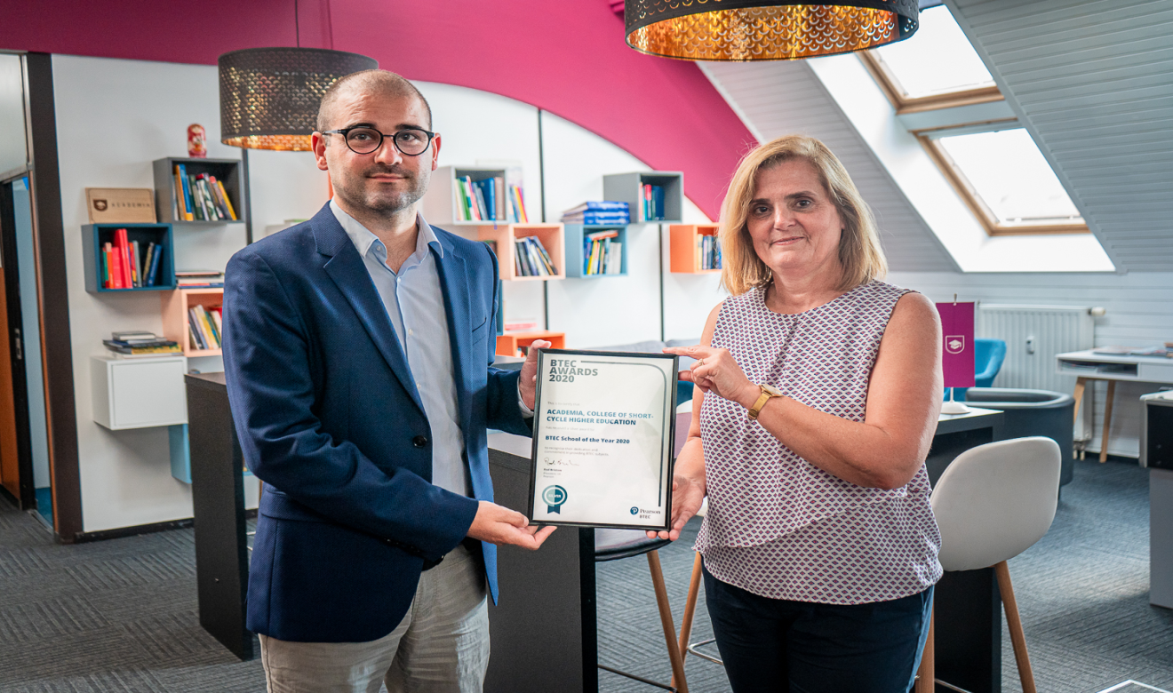


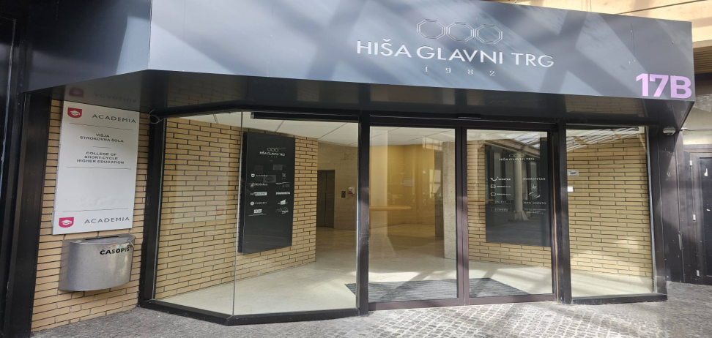
Business Proposal
Welcoming Session
Autumn Tech School

Slide 6

Business Proposal
About Mobility Program
The Blended Intensive Program offers an exciting opportunity for students and staff to dvelve into the emerging trends of Java Script programming.
Through dynamic learning experience participants engage in a combination of interactive workshops, lectures, and collaborative projects and improve their skills.

Slide 7


TIME TO DESIGN &
do some SERIOUS PROGRAMMING
About Povio
Povio is a San Francisco-based design and development company. They are collaborating with notable personalities like Serena Williams, multinationals like Volkswagen, and the world's best start-ups from Silicon Valley.
Their focus is on building digital products for both mobile and the web, where they use cutting-edge technologies and follow the latest trends throughout the development process.
Povio Challenge: Knowledge Sharing Tool
The main task is to create a centralized knowledge repository.
We would like you to develop a platform that brings together all of Povio's knowledge resources into a single, easy-to-access location. This should include images, links to blog posts, and written text.
Notes:
keila-hotzel-lFmuWU0tv4M-unsplash

Slide 8



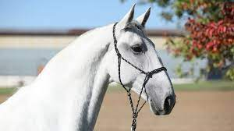


Business Proposal
Group WORK
All students were divided into international groups:
Triglav
Kurent
Potica
Lipizzaner
Pohorje
Drava

Slide 9

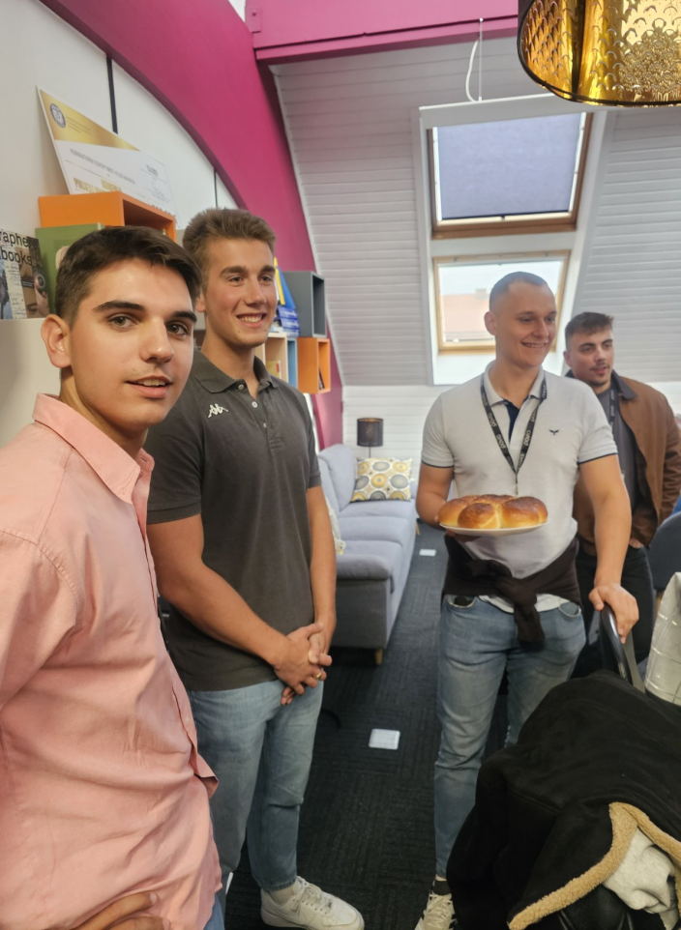
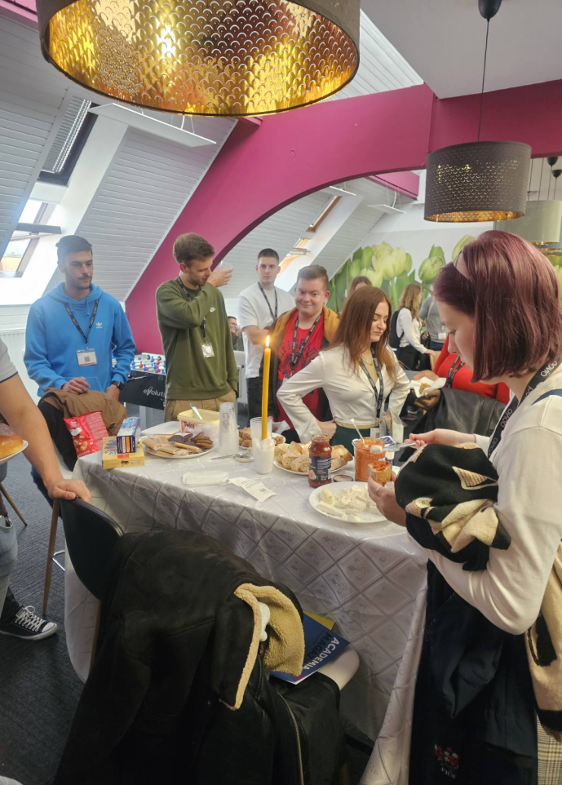
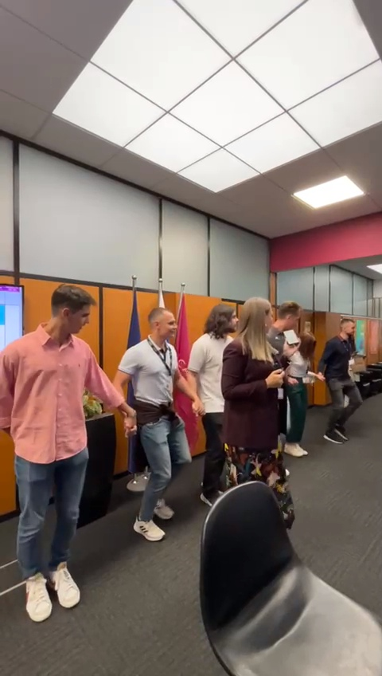
International Afternoon Event

Slide 10
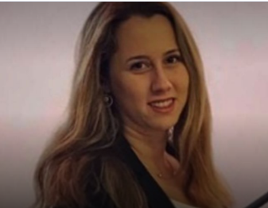
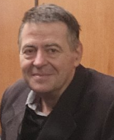

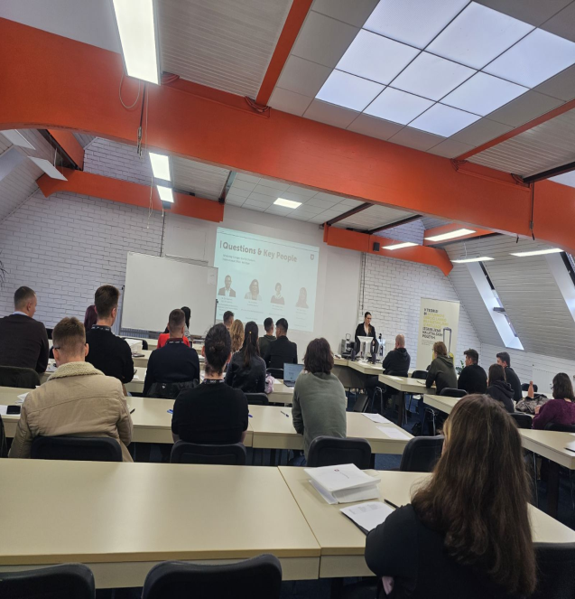
Business Proposal
Attending lectures
Prof. Tamara Vukadinović
Country: Serbia
Partner Organisation: Univerzitet Metropolitan, Belgrade
Prof. dr Zoran Lovreković
Prof. Stella Antolović
Edit Position Here
Country: Serbia
Partner Organisation: ATUSS, Belgrade
Country: Croatia
Partner Organisation: Algebra University College

Slide 11
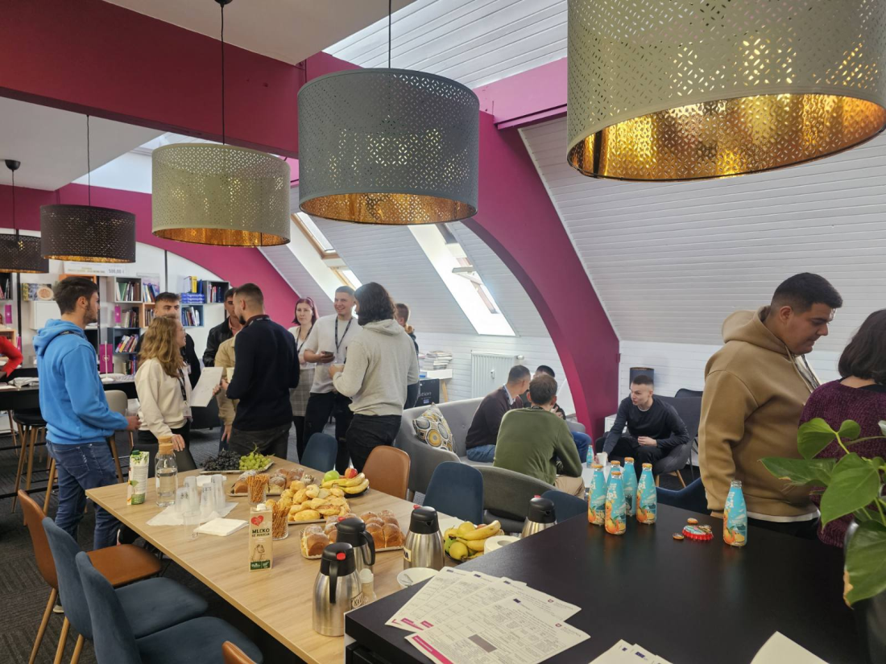
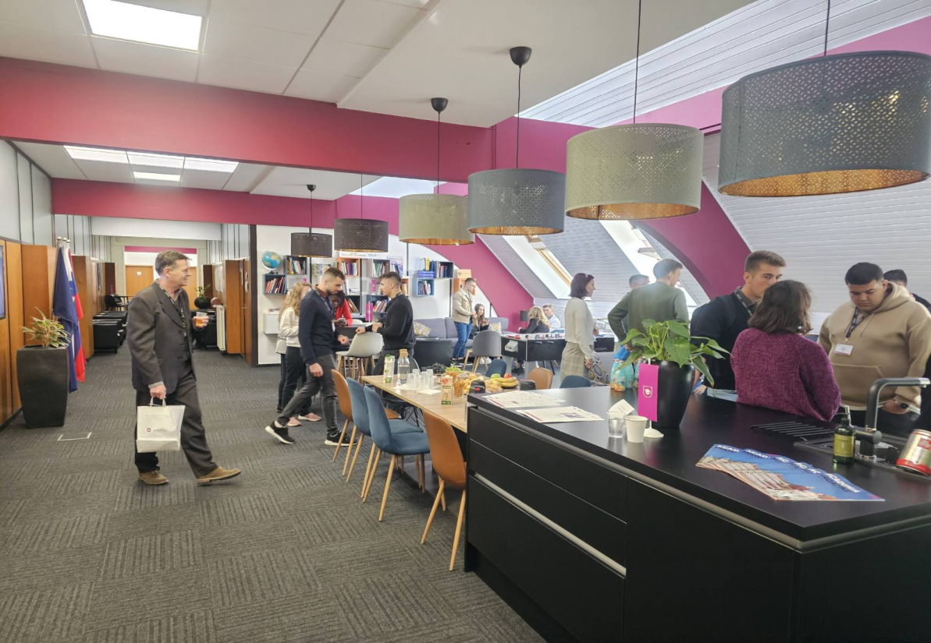
Mentors’ daily overview & consultations

Slide 12
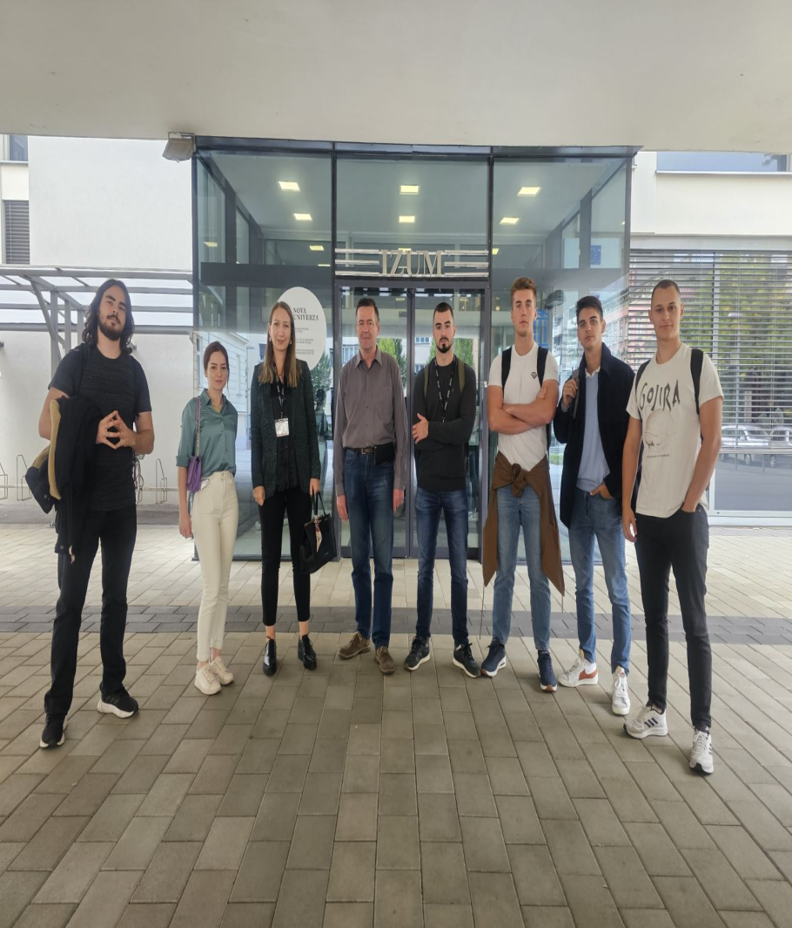
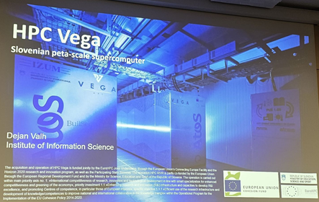
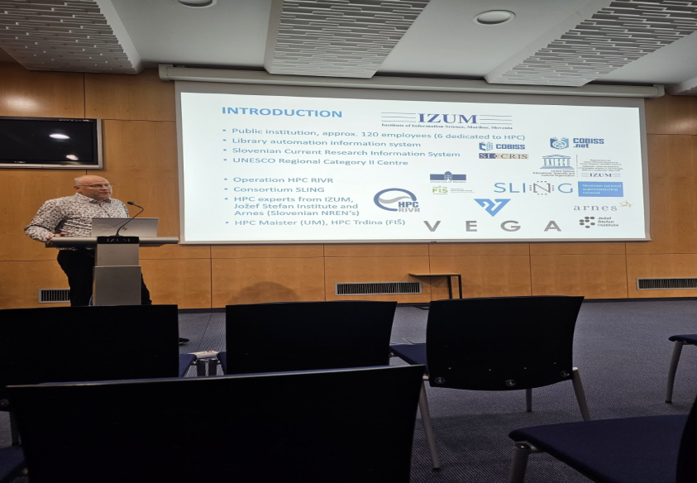
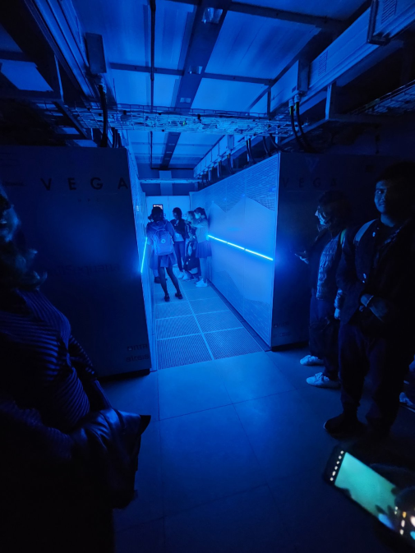
Visit to IZUM – Supercomputer VEGA

Slide 13
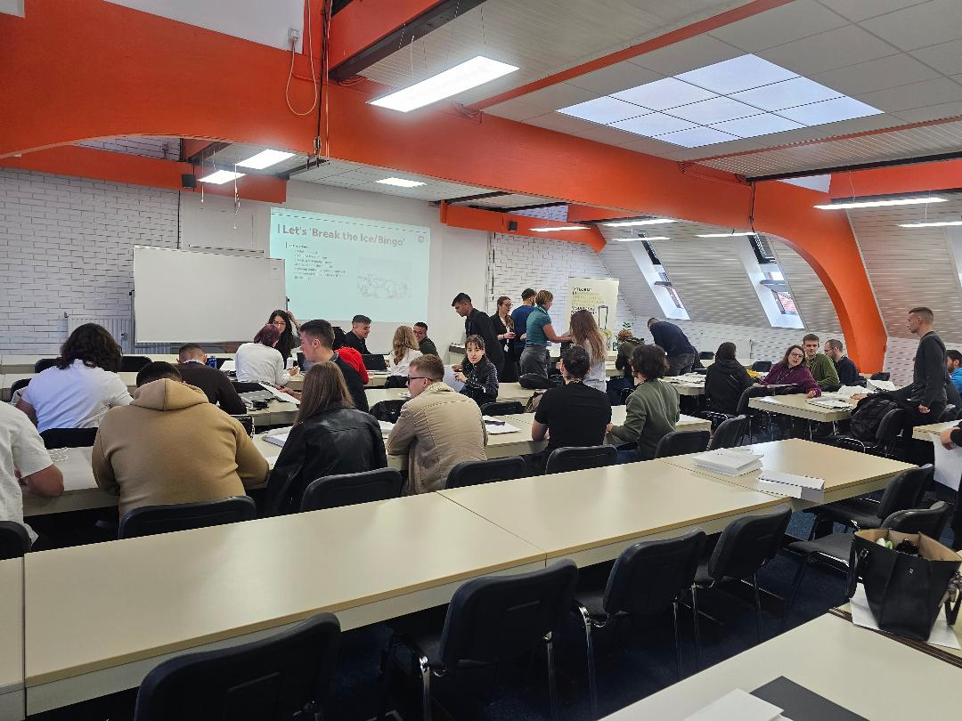
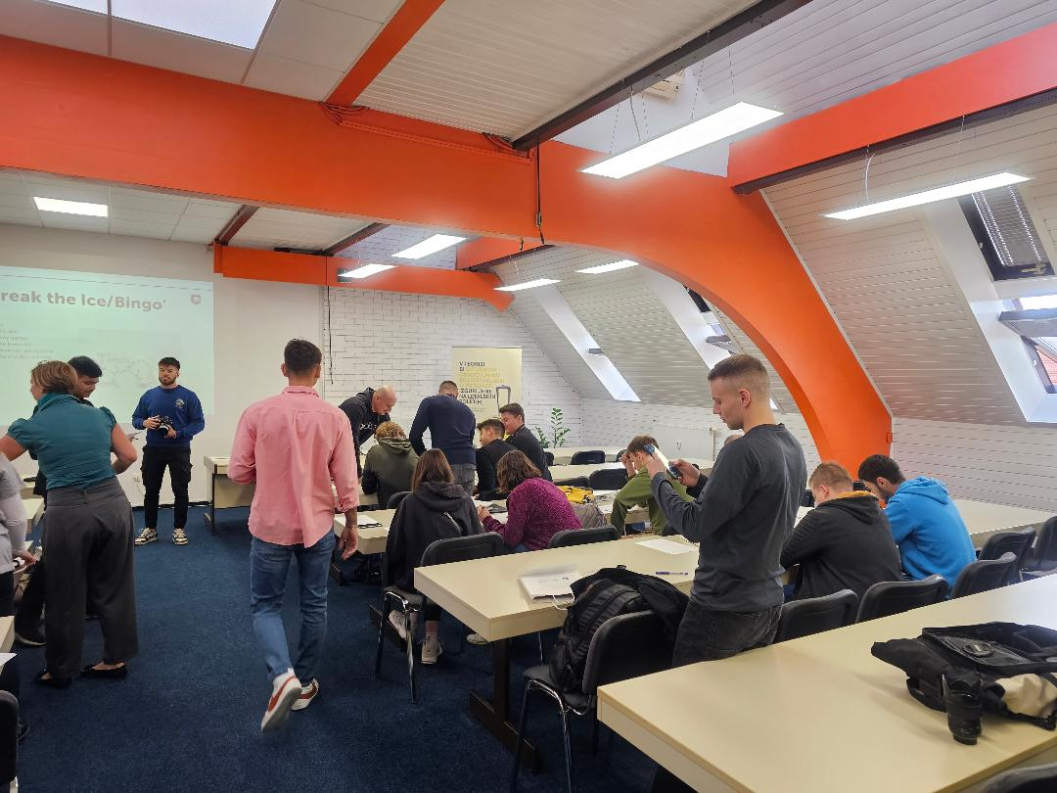
WORKSHOPS
Workshop
Student on a
Mobility:
Strengthening
Mental Health
(workshop by
Palacký
University
Olomouc)
Workshop
Student on
Mobility:
Stress
Management
(workshop by
Academia)
Pitch Workshop
(prof.
Stella Antolović,
Algebra
University College)

Slide 14


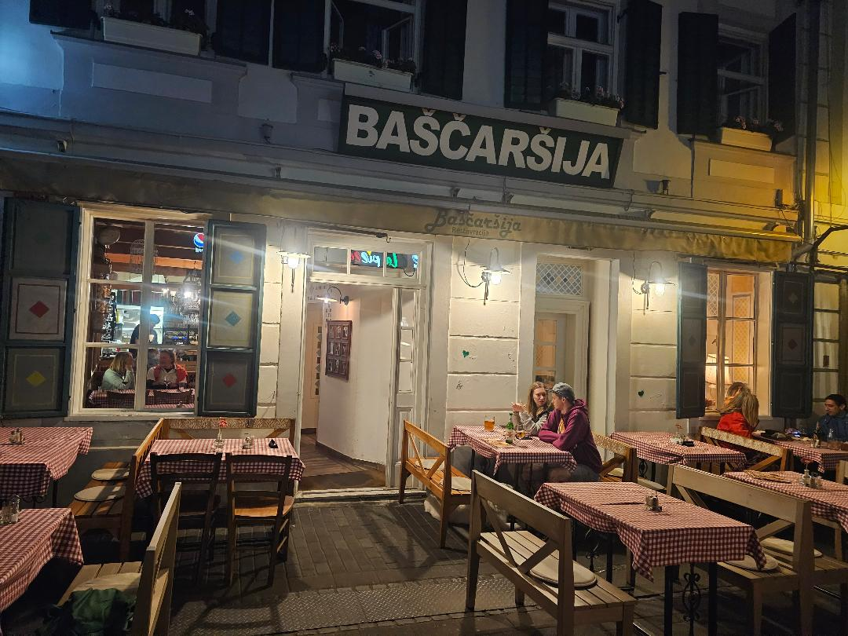
Exploring Maribor

Slide 15
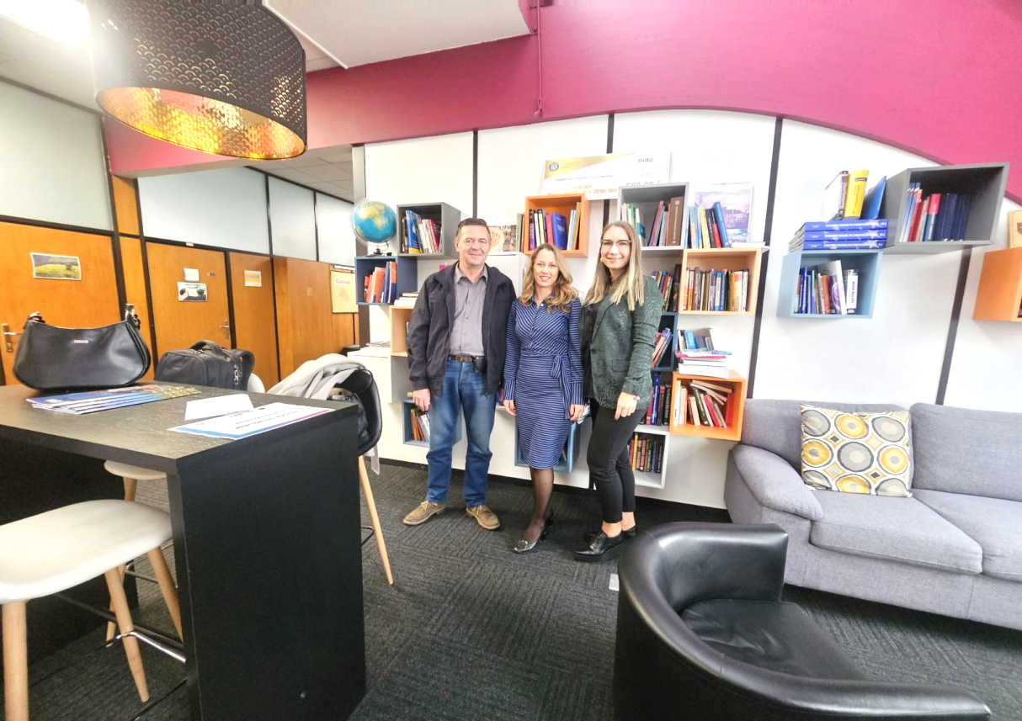
Pitching session & judging
Prof. Zoran Lovreković
Country: Serbia
Partner Organisation: ATUSS, Beograd
Prof. Doloris Bešić-Vukašinović
Country: Serbia
Partner Organisation: ATUSS, Beograd
Prof. Tamara Vukadinović
Country: Serbia
Partner Organisation: Univerzitet Metropolitan Beograd

Slide 16

Pitching session & judging
Prof. Stella Antolović
Country: Croatia
Partner Organisation: Algebra University College
Prof. Islam Mušić
Country: Slovenia
Partner Organization: ŠC Velenje
Leon Pahole
Country: Slovenia
Partner Organization: Povio

Slide 17
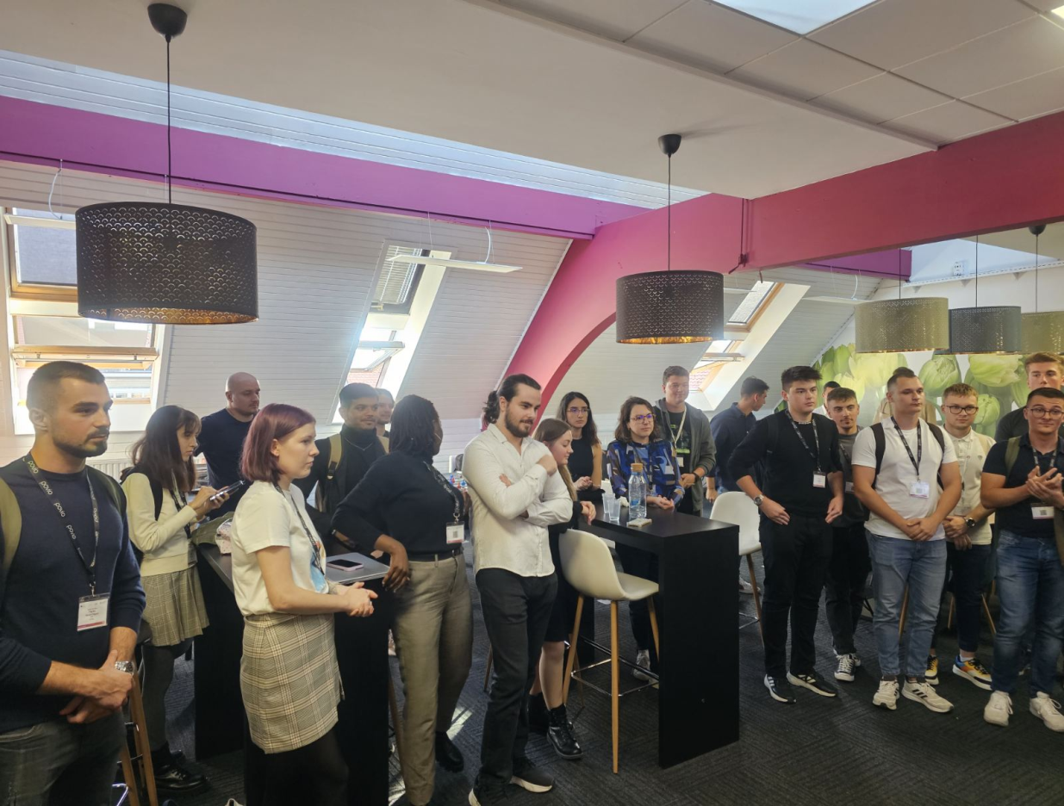
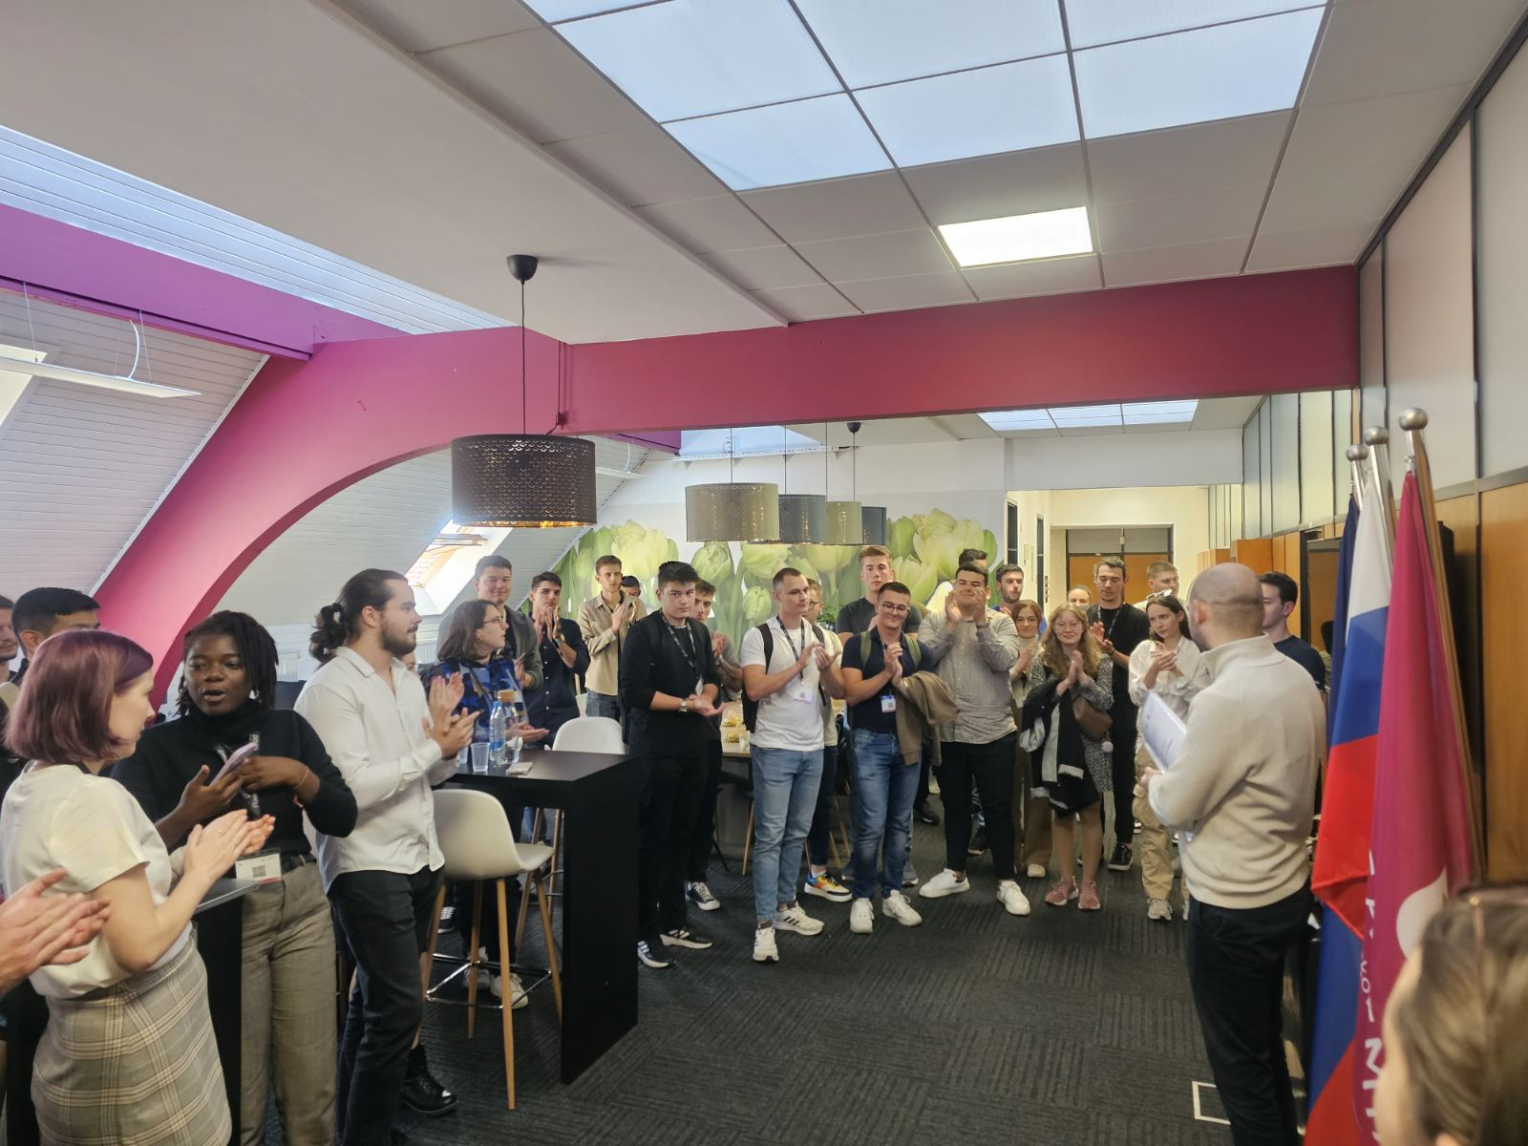
Certificates ceremony

Slide 18
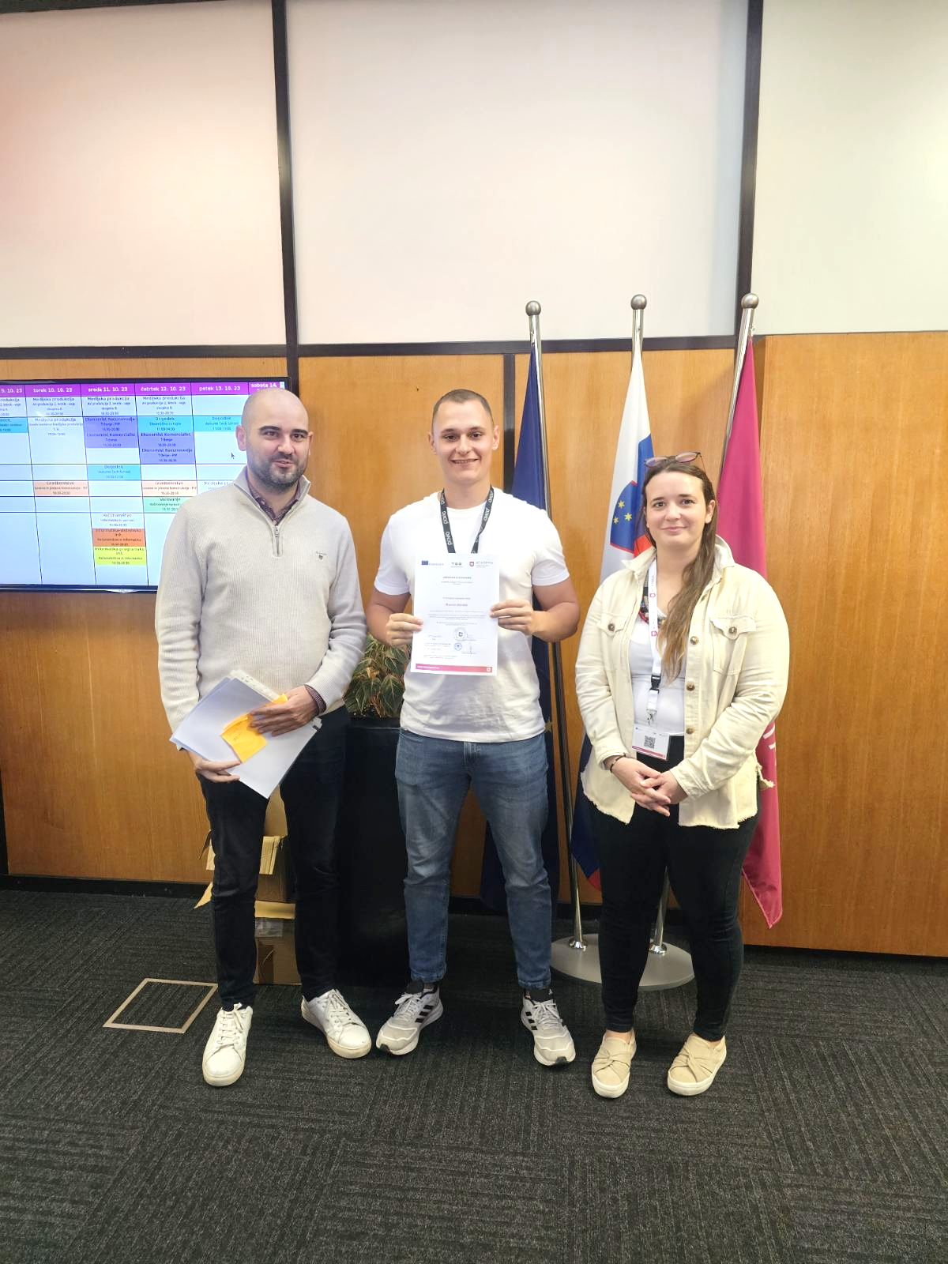
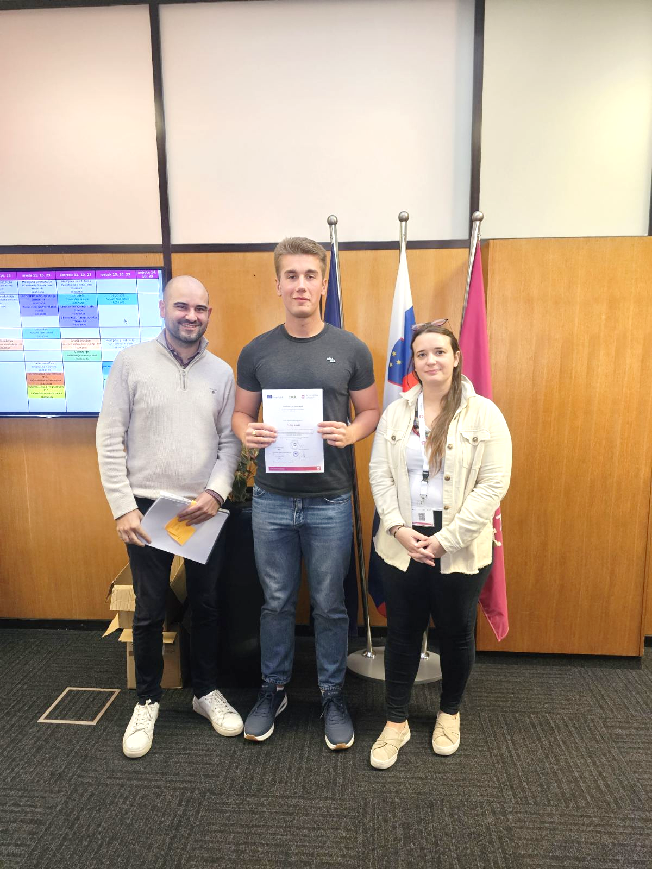
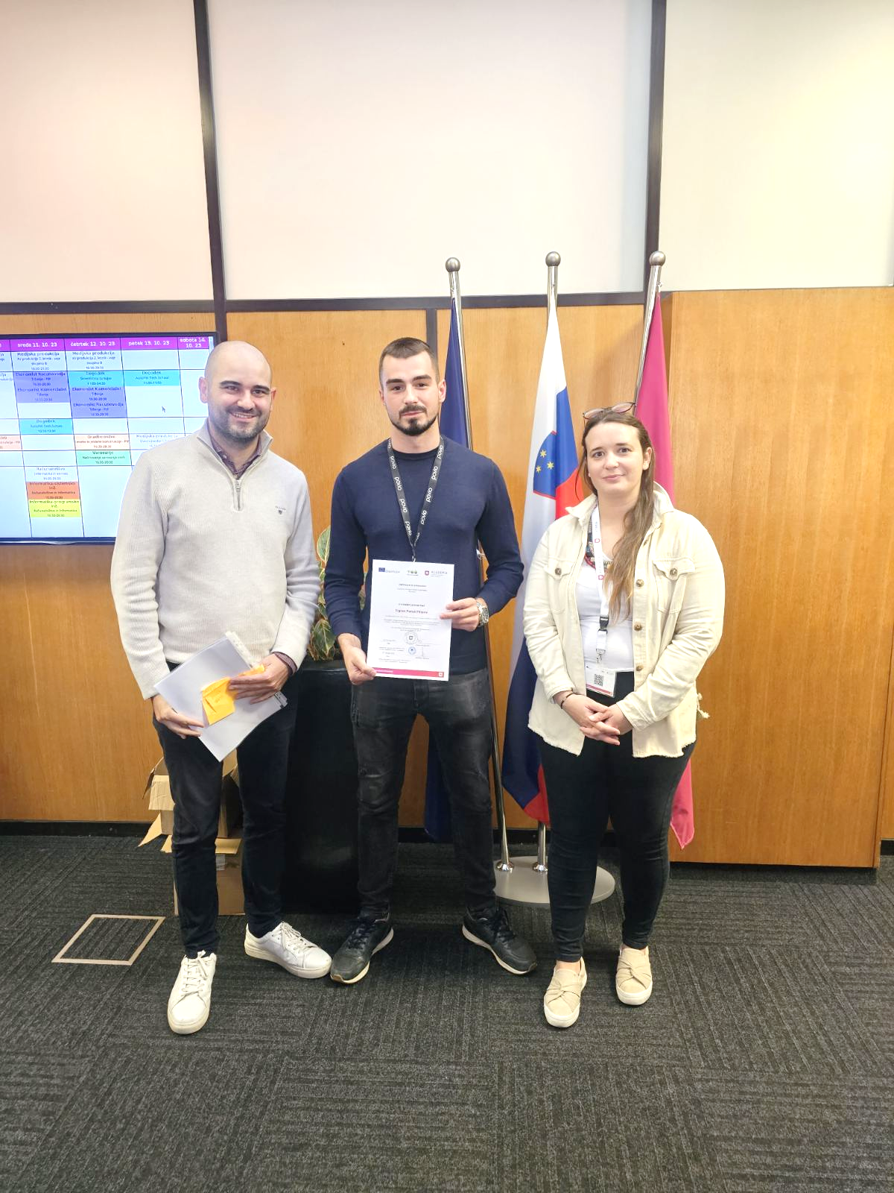

Slide 19
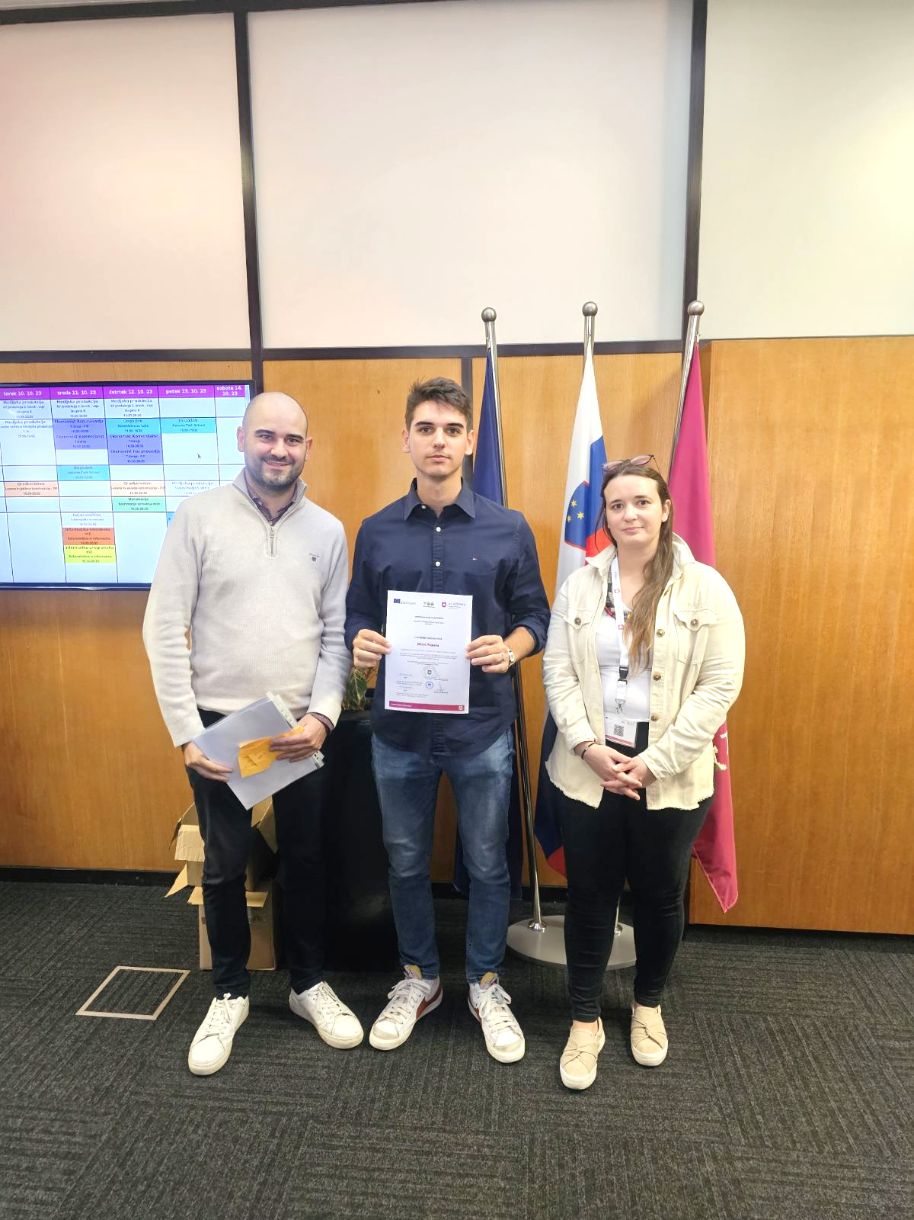
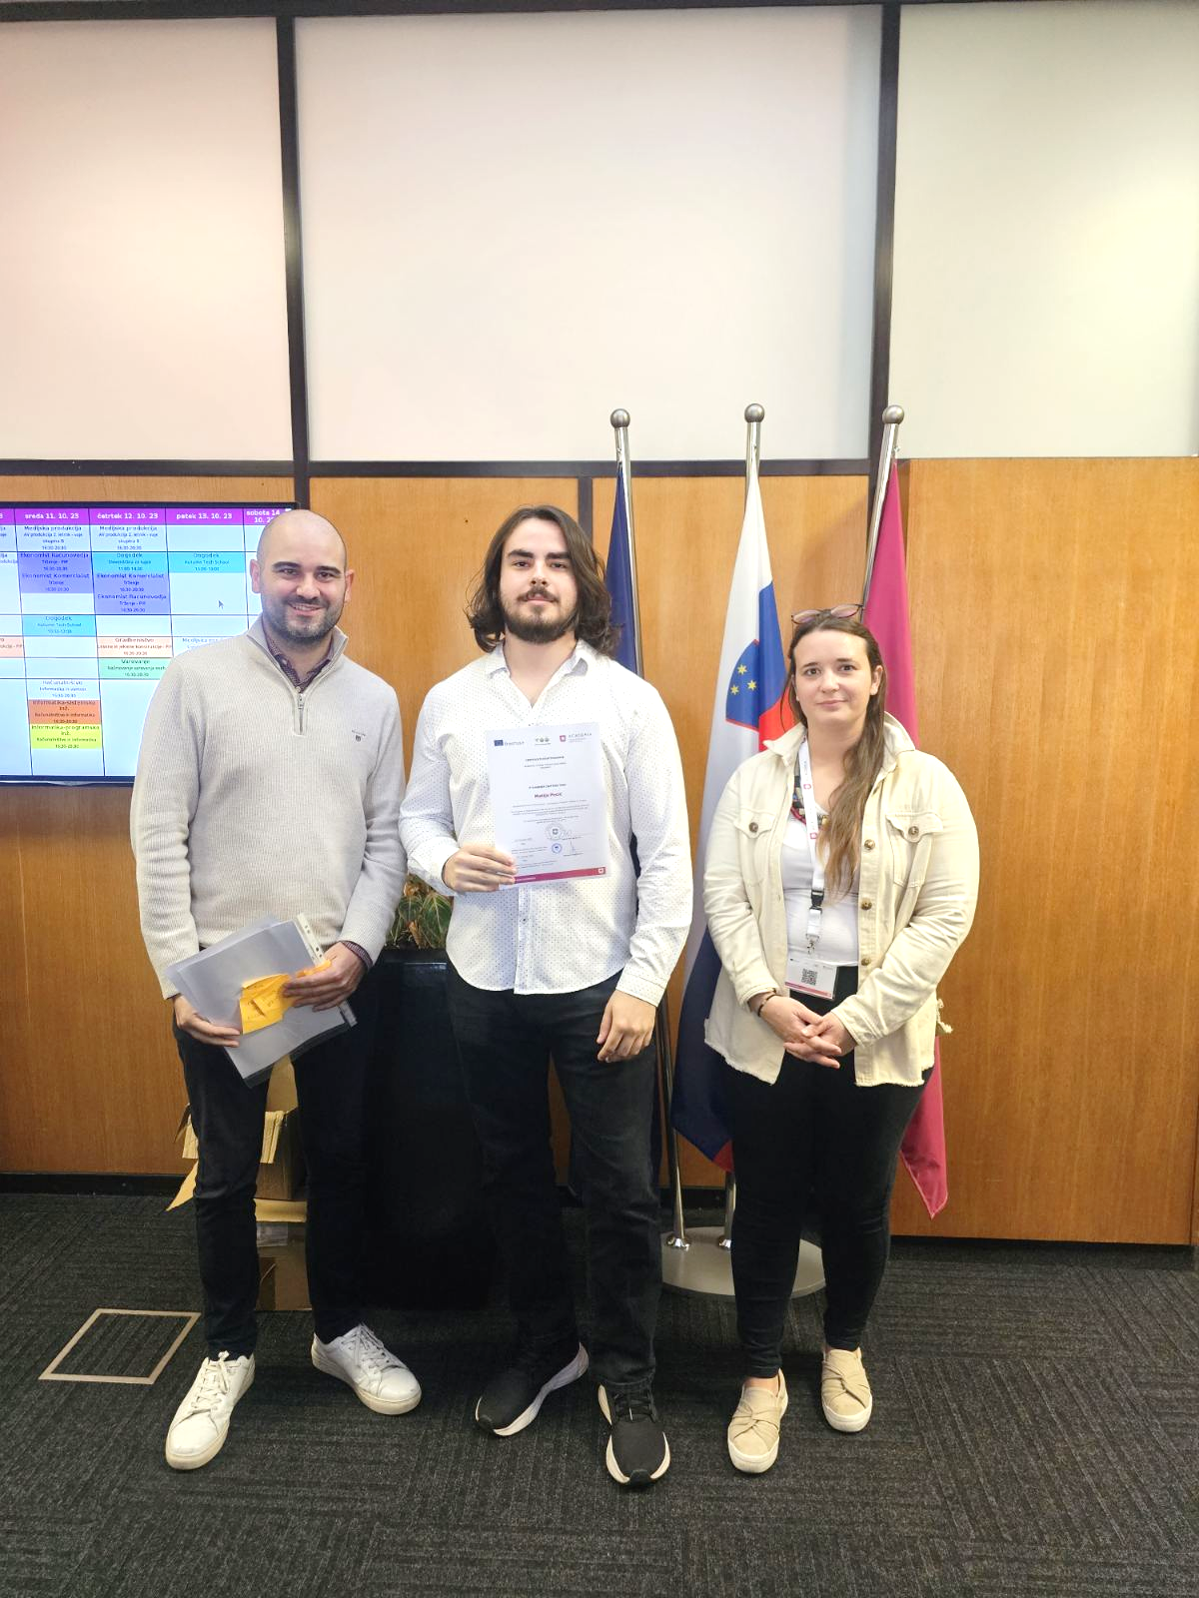
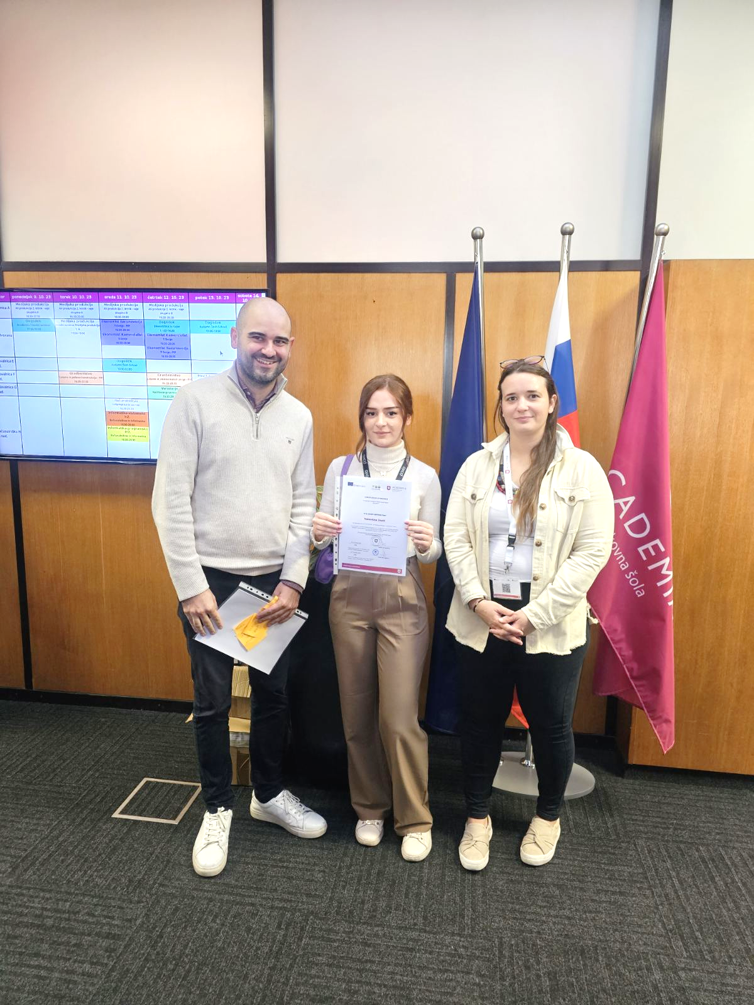

Slide 20
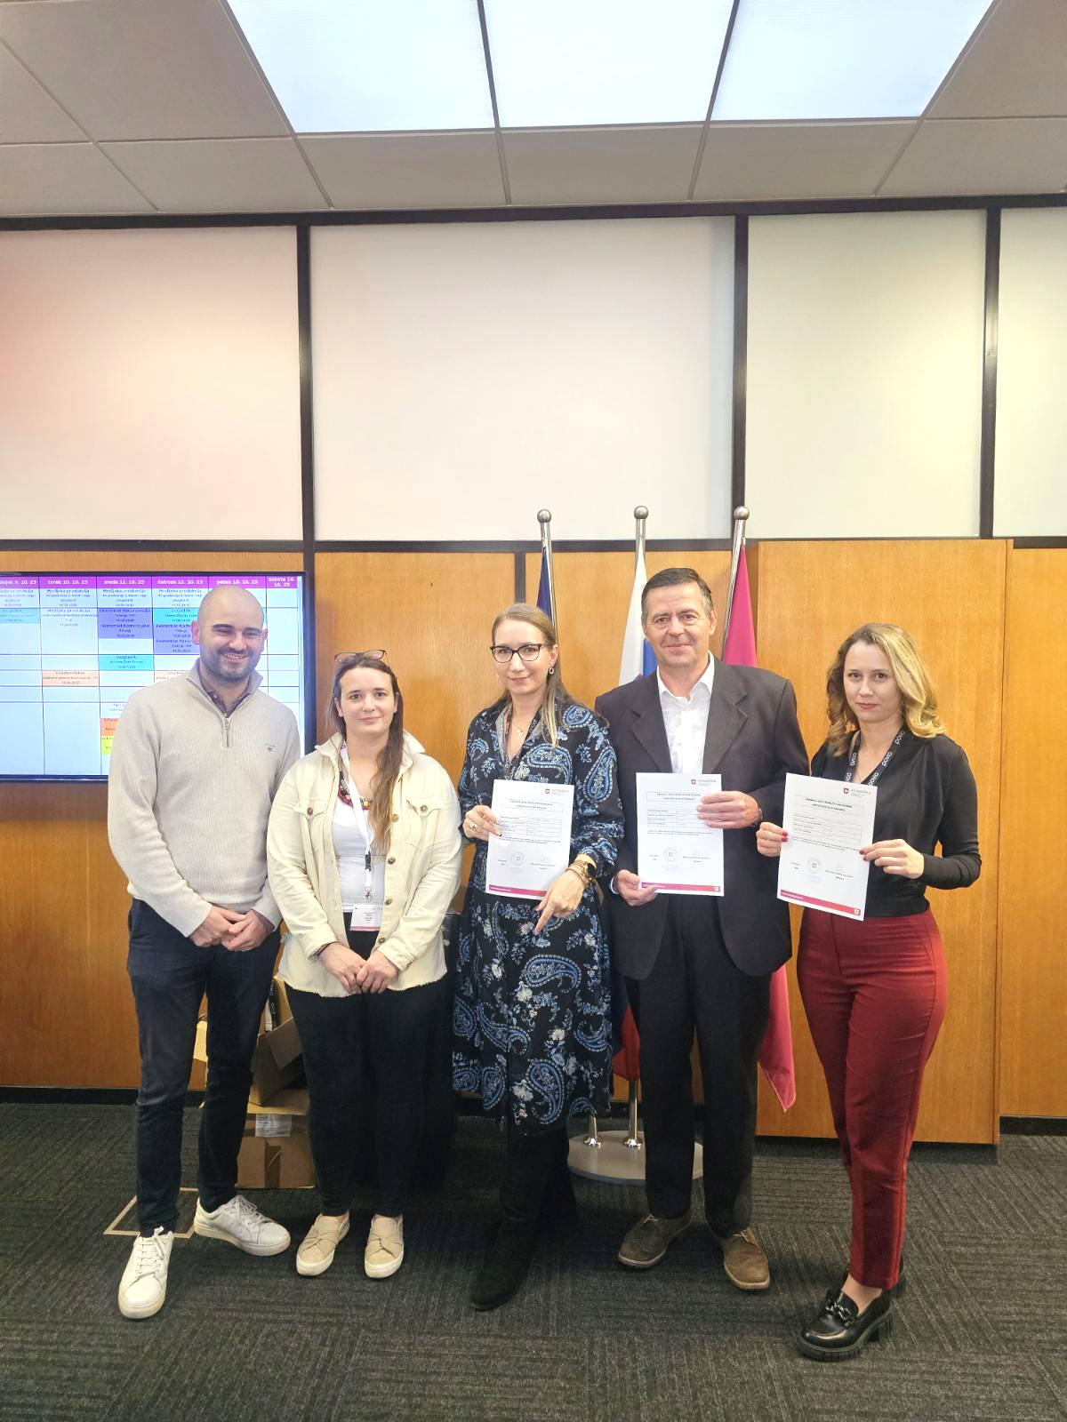
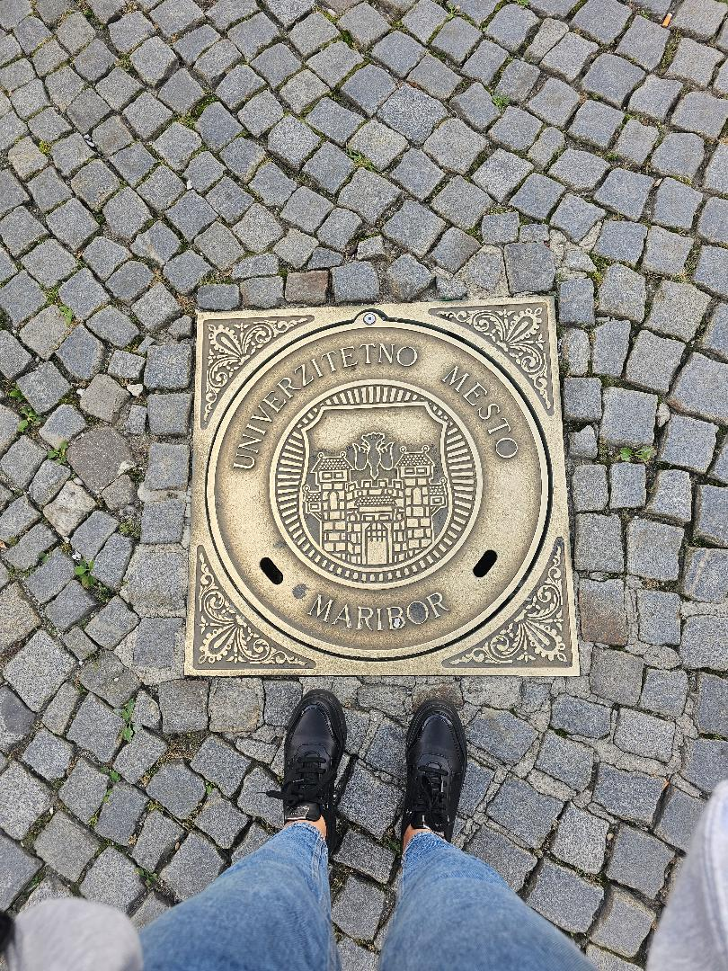
Task
successfully
completed!

Slide 21



